Slide 1
Basics of Environmental Statistics
Notes:
Welcome to the Basic Environmental Statistics course.
Large-scale environmental site investigations in US started in 1970s as a result of new laws and regulations, such as National Environmental Policy Act (1970), Resource Conservation and Recovery Act or “RCRA” (1976), and Comprehensive Environmental Response, Compensation, and Liability Act or “CERCLA or Superfund” (1980).
Unlike previous studies, these site investigations entail large amount of data, which form the basis for remedial decisions, including delineating the extent of impact, determining the level of risks, and identifying the appropriate remedy.
Site-specific data, however, often display variations, which are characterized as complex, random-like, and/or erratic.
From the very beginning it became clear that the analyses of such site data requires the use of statistical techniques. This is the course devoted to the understanding of these techniques.

Slide 2
Introduction
Presentation objectives
A review of environmental statistical applications
Focusing on strengths and weaknesses of common applications
Gain advantage in our project transactions
Notes:
Welcome notes

Slide 3
Topics
Statistics in Environmental Applications
Statistical Modeling
Sample Statistics
Skewed Sample Data
Graphical Techniques
Hypothesis Testing
Field Challenges
Advanced Techniques
Notes:
These are the topics that we will cover.
This information presented herein will provide you with a knowledge of statistics that will help you understand the terms and methodologies used in environmental site investigations and statistical analysis, such as risk assessment, attainment of cleanup, and background analysis.
This training is designed to present statistical concepts and analysis in an applied manner, rather than rote theory.
We will begin with “why do we need to use statistics?”

Slide 4
Why do we need statistics in environmental assessments?
Complex variability of field data
Source uncertainty
Heterogeneous soil, rock and sediment media
Complex hydrologic conditions
Partially known geochemical processes
Laboratory uncertainties
Uncertainty & Variability ~ Random variables
Statistics is the mathematical tool to process and analyze random variables
Notes:
Why do we need statistics in environmental assessments?
As you are well aware, there is much variability in nature:
The media in which we find contamination, mostly soil, rock and sediment are naturally heterogeneous, always a mixture of different types and sizes of solid material.
Hydrologic cycle, i.e. continuous movement of water in air, surface and subsurface, adds additional variability to the distribution of contaminants.
In addition, its hard to observe, measure and understand the natural processes that affect chemicals in the environment.
Dispersion, dissolution, contaminant transport are at best, only partially known and modeled.
Nature and the environment are well, naturally variable. (pun intended)
Also, the samples we collect in the field, and the measurements we conduct in the laboratory are never perfect.
The point is that there is much variability and uncertainty inherent in environmental processes. As a result, our typical site-specific data contain large amounts of unexplainable variations. So even when we have many samples in a small site, it is hard to exactly predict the level of concentration at an un-sampled location.
These uncertainties, although not intrinsic, are due to our limited knowledge. So from our point of view, our collected data have the properties of a random variable.
And Statistics is the best and the only techniques to process such random variables. Mathematics deals with “deterministic” variables, i.e. for a given input there is only one outcome. Statistics, on the other hand, deals with “random” variables, i.e. for a given input there are multiple outcomes possible. Each outcome has its own likelihood of occurrence or probability.
Statistics provide tools for modeling and analyzing random variables in order to make inferences. Such inferences allow us to determine whether we have adequate data, whether we have acceptable risks, and whether we have attained our cleanup goals.
Given the importance of these decisions, we need to love and embrace Statistics. So, let’s describe some common applications of Statistics in environmental site investigations.

Slide 5
Statistics and Environmental Applications
Statistics has been an integral part of environmental site investigations since 1970s when large-scale sampling activities were initiated throughout the United States
In environmental applications, statistics is used in a variety of problems, such as:
Site Characterization
Sampling Design
Attainment of Cleanup Goals
Risk Assessment
Compliance Monitoring
Notes:
In environmental site investigations, Statistics is used in a variety of problems, such as:
Site Characterization
Sampling Design
Attainment of Cleanup Goals
Risk Assessment
Compliance Monitoring
Let’s explore each of these problems through examples.
Ask participants to share their experiences, when discussing the above problems.

Slide 6
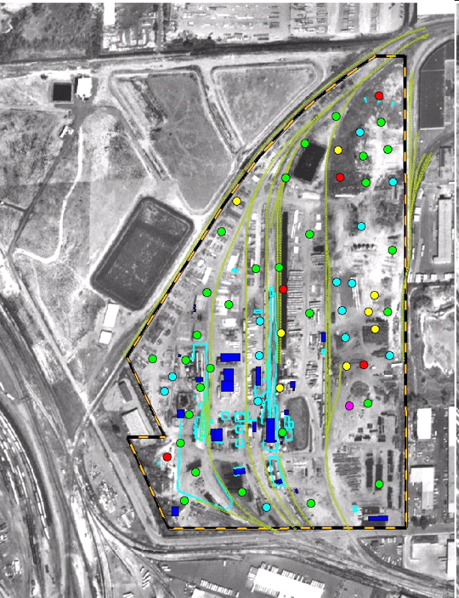
Common Problem: Site Characterization
Typical Situation:
Site characterization data are analyzed to delineate the vertical and horizontal extent of impact.
Questions:
Do the elevated concentrations represent impact or background?
If there is impact, what is the cutoff concentration between background and impact?
Statistics is used to determine background samples and threshold levels.
Impact or Background?
Notes:
Site characterization data have been collected to delineate the vertical and horizontal extent of impact. Now the question is: “are the elevated concentrations indicative of impact or background?” And if there is impact, what is the background cutoff?
Statistics provides tool to address this problem by modeling both background and impact concentrations as random variables, i.e. variables that cover a range of concentrations.
Under this statistical approach, the background and site datasets are compared to determine whether the site dataset is “significantly” higher than the background dataset. This analysis is often referred to as the “Comparative Method.”
Anomalous concentrations, which are substantially higher than background concentrations, are indicative of impact. On the other hand, in many instances, presence of few isolated values, may not indicate impact. Statistics provides tools to address these issues in a quantitative manner.
Furthermore, if site data proved to be indicative of impact, Statistics offers procedures to determine the upper threshold value of background (“background cutoff”). This cutoff will be computed consistent with a specified confidence, i.e. the preferred “safety factor”:
Higher safety factor → lower background cutoff
(Invite participants to discuss their own similar projects.)

Slide 7
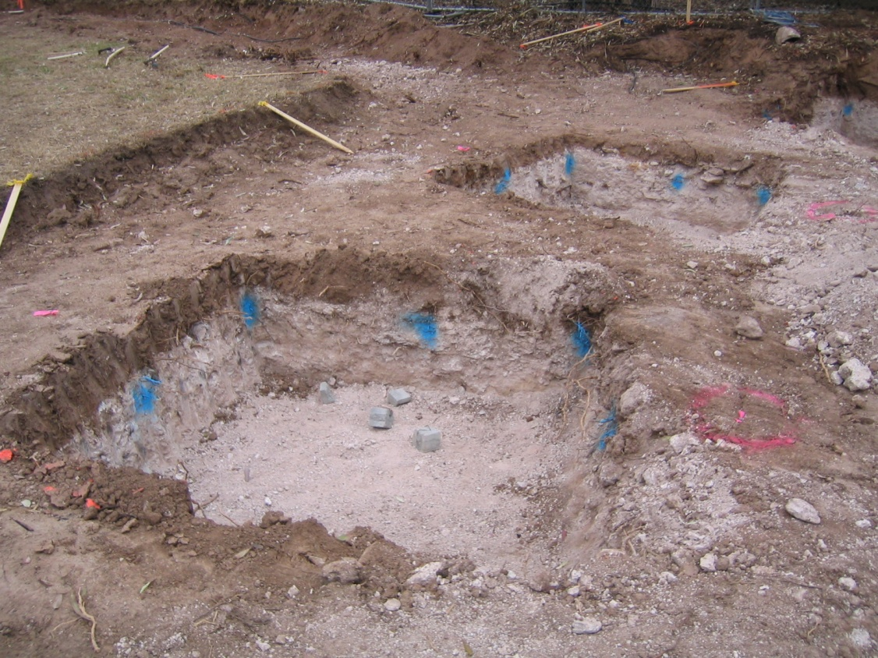
Common Problem: Sampling Design
Typical Situation:
An impacted area has been excavated.
Question:
How many samples are needed to adequately confirm the attainment of cleanup goals?
Statistics is used to determine the minimum number of samples for attaining a specified confidence.
Notes:
Consider now the problem of designing a sampling plan for confirmation of attainment of soil cleanup goals at an excavation site.
If you expected little or no variations in post-removal soil concentrations, one sample would be adequate. However, there is always some variations due to natural variability of background soil concentrations, as well as the possibility of leaving some impacted soil behind. As a result you need more than one sample, and so the question: “how many samples are needed to adequately confirm the attainment of cleanup goals?”
Statistics provides procedures to address this problem by viewing the soil concentrations along the excavation boundary as a random variable with a mean + a variability. Under this scheme, the number of samples depends on:
Soil concentrations variability: Higher variability → more samples
(More samples are needed in order to cover the entire range of possible concentrations)
Reliability of conclusions: More reliability → more samples
(More samples result in a reduced likelihood of errors, and thus, higher reliability.)
Cleanup goals: Lower cleanup goal → more samples
(As the cleanup target decreases, more samples are needed to ensure that the remaining soil meet the target.)
(Invite participants to discuss their own similar projects)

Slide 8
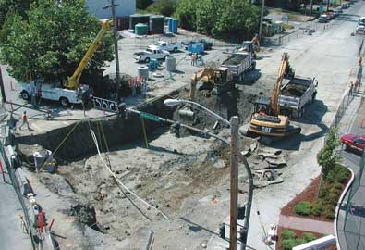
Common Problem: Attainment of Cleanup Goals
Typical Situation:
Post-excavation confirmatory data have been collected, which may include few elevated data.
Question:
Do available data confirm attainment of cleanup goals, or more excavation should be pursued?
Statistics is used to evaluate whether a conservative estimate of mean concentration complies with the cleanup goal.
Notes:
Now the results of confirmation samples are available, which may include few elevated hits. Have we attained soil cleanup goals or should we pursue more excavation?
As early as late 1970s, EPA planners realized that even the most meticulous excavation procedures may leave “insignificant pockets of contamination.” The question is: Should we consider these “pockets of contamination” as insignificant or pursue more excavation?
Statistics provides tools to address this question by computing conservative estimates of mean concentrations, which are referred to as the “upper confidence limit of the mean” or simply “UCL”.
UCLs are driven by computed mean, observed variability, preferred confidence level, and number of samples. As long as UCLs are below the target level, confirmation hits are viewed as “insignificant pockets of contamination.” In contrast, elevated UCLs would point to additional sampling or excavation.
(Invite participants to discuss their own similar projects.)

Slide 9
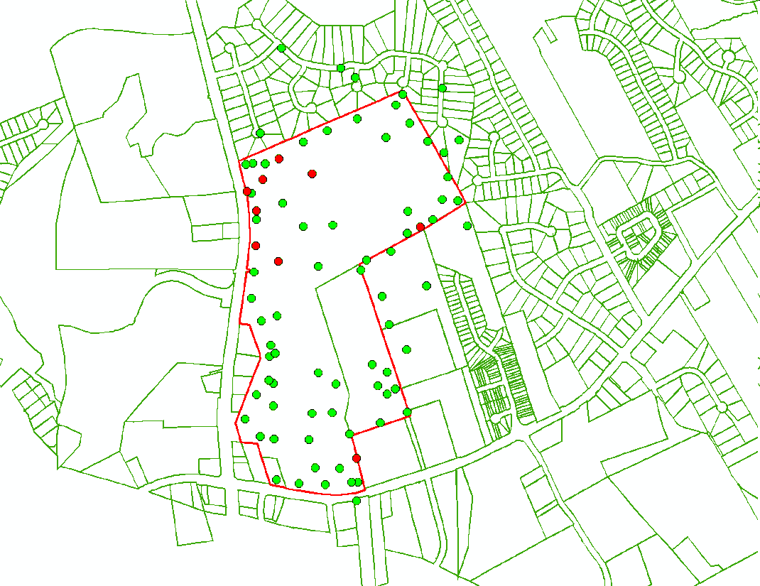
Common Problem: Risk Assessment
Typical Situation:
Site-specific risks posed by contaminants of concern (COC) must be computed.
Questions:
What chemicals are background, and not COCs?
What are the representative concentrations of COCs?
Statistics is used to determine background chemicals and to compute the exposure concentrations of COCs.
Notes:
Consider now a typical risk assessment problem. Usually a large number of samples have been collected and analyzed for a variety of contaminants. The immediate task is to compute the level of environmental risks posed by the site “contaminates of potential concern” or “COPCs” or simply “COCs”.
The first question is: which chemicals are COCs, and which ones are background chemicals? Statistics provides tools to compare site and background datasets to determine if a chemical is background or not. These procedures are commonly referred to as “two sample tests.”
If a chemical proves to be a COC, then its representative concentration must be computed. EPA Risk Assessment Guidance for Superfund Sites or “RAGS” indicates that this concentration must be representative of mean concentration of the COC over the exposure area.
Exposure areas are usually much smaller than our site, so we may only have few samples per exposure area. The mean of few samples within an exposure area is not a reliable estimate of its true mean concentrations.
For such cases, statistics provides procedures to compute a conservative estimate of COC’s mean concentration. For this purpose, it adds a “safety factor” to the actual computed mean. This factor of safety will be high if the available chemical data shows high variability, or if the number of samples is limited.
(Invite participants to discuss their own similar projects.)

Slide 10
Common Problem: Compliance Monitoring
Typical Situation:
Compliance groundwater monitoring at RCRA Landfills
Questions:
What is the background threshold level?
Is an observed hit at a compliance monitoring well indicative of a release?
Statistics is used to determine the significance of the observed exceedances.
Compliance
Well
Up-gradient
Well
Observed Concentration
time
Notes:
Consider now a groundwater monitoring plan at a RCRA landfill.
Quarterly samples are collected from a number of compliance and background wells. The measured concentrations vary from time to time and from location to location.
Typical questions are: What is background threshold level? What concentration signifies a release? And, when should we implement our release contingency plans?
Statistics recognize the variability of concentrations, and provide tools for defining threshold levels. If concentrations exceed these threshold levels repeatedly, then contingency sampling must be implemented.
(Invite participants to discuss their own similar projects.)

Slide 11

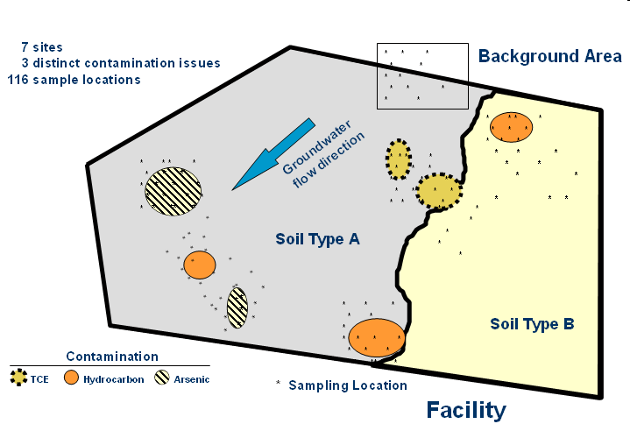


Distinct Features of Environmental Applications
Typical Statistical Application:
Decision are made based on random (unbiased) data
Example: Clinical trials
Random samples are often not representative ⇒ Sampling Error
Typical Environmental Applications:
Decisions are made based on judgmental (biased) data
Example: Site investigations
Data are often aimed to be representative
New Drug Placebo
Group A Group B
Be aware of limitations of statistical procedures
Notes:
In most instances, judgmental (biased) data collected in environmental applications are inconsistent with basic assumptions of a typical statistical analysis.
Therefore, prior to the use of any statistical procedure, the impacts of judgmental data must be assessed in order to avoid unreliable and/or inconclusive results.
Open discussions about such problems, such as site data sets that are much larger than the background data sets leading to false positives….

Slide 12
Topics
Statistics in Environmental Applications
Statistical Modeling
Sample Statistics
Skewed Sample Data
Graphical Techniques
Hypothesis Testing
Field Challenges
Advanced Techniques
Notes:
Mathematics deals with the “deterministic” variable, which is not random. So under a given condition, a deterministic variable always yields the same unique outcome.
Statistics, on the other hand, deals with the “random” variable, which yields different outcomes under a given condition. Now we will discuss, how statistics models the random variable.

Slide 13
Statistical Modeling
Random variable can acquire more than one value due to natural variability and/or uncertainty
Population is the set of all the values of the random variable
Distribution defines the likelihood of occurrence of each value of the random variable.
Histogram/Discrete; Probability Mass Function
Continuous; Probability Density Function
Notes:
A Random Variable can acquire more than one value under a given condition. This can be due to either natural variability or uncertainty.
An example of natural variability is the range of metal background concentrations in soil. Uncertainty, on the other hand, is mainly driven by the limits of our knowledge. For example, estimate of concentration at an un-sampled location contains uncertainty.
Uncertainty can be reduced with increased knowledge, such as additional sampling. However, “Variability” cannot be reduced with increased sampling; it simply gets better defined with more samples.
As we collect more information about a particular random variable, such as soil concentration, we find that the variable has a certain range of values, from a minimum to a maximum, and that some values will occur more often, and some less often.
The total set of all possible values of a random variable is referred to as its Population. For example, when we are measuring height of students in a given high school, the population is the collection of the heights of all students in that high school.
A random variable is modeled by its Distribution. Distribution defines the likelihood of occurrence of each outcome of the random variable. The simplest distribution involves only two possible outcomes, a binary distribution, such as head-or-tail or a 50-50 chance. Dice has 6 outcomes, each with 1/6 likelihood to occur.
As the number of our outcomes increases, we use histograms, as shown on the left. In this example, the random variable has 11 outcome intervals or “bins”. The height of each bar corresponds with how many occurrences are within a certain interval.
The histogram is a discrete probability distribution function/model, as it models the distribution of a random variable, organized into discrete intervals. This function is sometimes referred to as the “probability mass function.”
A continuous probability function model portrays the same information, but assumes that there are infinite number of outcomes, rather than discrete intervals. This function is sometimes referred to as the “probability density function.”

Slide 14
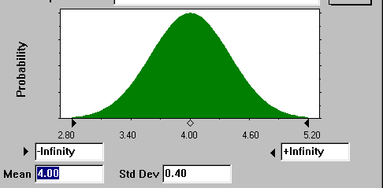
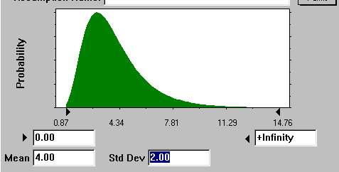
Common distribution models
Normal (Gaussian) distribution
Symmetric
Central Limit Theorem: Sum of random variables tends to normal distribution regardless of the distribution of constituent variables
Lognormal distribution
Random variables whose logarithms are normally distributed
Skewed
Common for environmental parameters
Notes:
There are many mathematical functions that can be used to model a continuous distribution or discrete distribution function. The most common probability density function is the “normal”, or Gaussian distribution shown on top here. This distribution describes a “bell-shape” distribution that is symmetrically distributed about a central point, or average. This distribution is named after the German scientist Carl Friedrich Gauss (1777-1855). Until few years ago, Gauss’s portrait adorned the face of the 10 Deutschmark bills. So you can see the importance the German give to this genius.
The importance of the normal distribution is attributed to the “Central Limit Theory,” which states that any sum of random variables has a tendency to normal distribution regardless of the distribution of the constituent variables.
Important example: “Average” or “mean” concentration is the sum of measured concentrations divided by the number of measurements. This “average” has a tendency to normality even when the individual concentrations have skewed (asymmetric) distribution.
In fact, in most field cases, concentration data have highly skewed shape, which is usually modeled with the use of a log-normal distribution. This skewness can often be the result of the way we collect our data, i.e. few samples from source contamination, many samples from the contamination boundary areas, along with few “background” samples.
Important Note: When you are working with a variable, make sure that you are using its appropriate distribution. Examples:
(1) If you are dealing with “UCLs” in risk assessments, you are working with “mean” concentrations. Remember that regardless of the distribution individual concentration data, the mean concentration has a tendency toward normal distribution. This tendency becomes strong when you have more than 20 measurements with low variability.
(2) On the other hand, if you are dealing with “upper threshold values of background concentrations,” then you working with the distribution of the individual concentration data. In almost all cases, this distribution is skewed (looking like log-normal distribution).
We will discuss Lognormal distributions in more detail later.

Slide 15
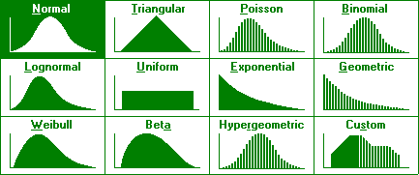
Distribution models
Source: Crystal Ball Version 4
Notes:
There are many other mathematical distributions in addition to the Normal and Lognormal distributions used to model distributions of random variables. Some are pictured here, courtesy of the Crystal Ball software program.
The only ones worth mentioning at this time are the Triangular and the Uniform and the Beta distributions, as you may see these in environmental applications.
The Uniform distribution simply means that any value within the defined range is equally likely to happen. Like the rolling of a dice, each number has an equal chance of occurring.
The triangular distribution is also intuitive, where there is one value most likely to occur, with uniformly decreasing probability to the minimum and maximum values.
The Beta function offers a flexible model for skewed data. Recent work by EPA shows the advantages of this function versus log-normal model.
These functions are commonly used to model the variability and uncertainty distribution of environmental data. Each distribution has one or more “parameters” that define the shape and location of the distribution.
For example, the normal distribution has two parameters, i.e. the mean and the standard deviation. Available data are used to estimate these parameters, which are often referred to as “descriptive summary statistics”.

Slide 16
Descriptive summary statistics
Central tendency:
Mean: Arithmetic average, μ
Median: 50 percentile value
Mode: Value with the highest occurrence frequency
Dispersion, spread:
Standard deviation σ; (variance, σ²)
Coefficient of variation (CV) = σ/μ
Symmetry:
Skewness: Measure of asymmetry (= 0 for symmetric distributions)
Distribution tails:
Minimum/maximum
P^{th} percentile or quantile
25 percentile, 75 percentile (quartiles)
Kurtosis
Notes:
The most common summary statistic is related to the Central Tendency of the distribution model. There are three common measures of central tendency, which are the mean, the median and the mode.
The mean is the arithmetic average of all population units. The median is the 50th percentile, meaning 50% of the population values are less than the median and 50% are greater. The mode is the value that occurs the most, regardless of what percentile it is.
The next important summary statistic measures the Dispersion or Spread of the distribution model. The Standard Deviation, which is the square the variance, quantify how dispersed the data are. The greater the standard deviation, the more widely spread the distribution.
The mean and the standard deviation are the two most commonly used parameters to describe a distribution. The coefficient of variance is computed by dividing the standard deviation by the mean, and is useful as a relative measure of dispersion.
Other lesser used, but still useful statistics are related to the Symmetry and Tails of the distribution model. Among these maximum and minimum, as well as percentiles are often calculated in environmental site investigations.
Percentile is the value of a random variable below which a certain percentage of the variable fall. For example, 30% of the data values lie below the 30-percentile.
Quantile is another term used for percentile.
25 and 75 percentiles are sometimes referred to as the first and third “quartiles”, respectively.

Slide 17
Why descriptive summary statistics?
Quantitatively describe, summarize, and document data distribution
Communicate results to scientists, regulators, and public
f(x)
Log-normal
=
0.0
0
10
20
30
x
Notes:
Summary statistics like the mean, standard deviation and percentiles are essential to describe, summarize, assess and compare distribution of your data. Summary statistics are also the way we can communicate to others information on distributions.
For example, each time that you took an exam, your teacher had the complete list of grades. In other words, the teacher had the knowledge of the entire “population.” However, rather than giving you all the grades, he or she had to only give you the mean (average) and the standard deviation. Just knowing these two values would enable you to measure the status of your grade. You intuitively knew that if your grade was one standard deviation higher than the mean, then a grade “A” was likely.
So you see, how two “descriptive statistics” helped you to make a “statistical inference.”
In this example, your teacher had full knowledge of the “population.” It is very important to point out that so far, we are assuming that we know all the values of a random variable. Again, I will repeat, up to now, we are assuming that we know all the values of a random variable in a distribution. This means that we have full knowledge about the entire “population” - just like the teacher in our example.
In environmental site investigations, however, often we do not have full knowledge of the population. For example, a contaminated site can be many acres large, consisting of thousands of cubic feet of contaminated soil. Bur our knowledge is limited to few tens of samples. A typical sample jar is 4 oz or 0.004 cubic feet. So we only know about a small sample of our site, which is our “population.”
The question is how to make inferences, based on a limited knowledge of the population, which leads us to the important topic of “Sample Statistics.”

Slide 18
Topics
Statistics in Environmental Applications
Statistical Modeling
Sample Statistics
Skewed Sample Data
Graphical Techniques
Hypothesis Testing
Field Challenges
Advanced Techniques
Notes:
Sample Statistics is the essence of statistical analysis in environmental applications, such as site investigations, defining nature and extent of contamination, risk assessment, and background analysis.

Slide 19
Sample Statistics
Target Population
All values/units of a target population
All particles of contaminated soil
Sample Population
Values/units in the population that are available for measurement
Accessible locations for soil sampling
Sample Set
Values/units in the Sample Population that are known
Laboratory analyzed soil samples
Notes:
Let us consider the basic elements of sample statistics within the context of our site investigations.
In a contaminated site, we are usually dealing with thousands of cubic feet of contaminated soil. This is our “population.”
Risk assessment requires the knowledge of average concentration of contamination over the entire exposure area. This is referred to as the Exposure Concentration. Determining the magnitude of the Exposure Contamination is a “statistical inference.”
To calculate the exact level of exposure concentration we need to know the level of contamination at every single molecule of soil in our site. This task, however, is infeasible, if not impossible.
So instead, we identify zones where we can collect sample - locations that are accessible to our samplers, such as open and/or unpaved areas. This is our “Sampling Population.”
We then collect a number of soil samples, each containing about 4 oz (0.004 cf) of soil, which is an infinitesimally small portion of our population. After laboratory analysis, we will know the contaminant concentrations in our soil samples. These results constitute our “Sample Set.”
We now calculate the arithmetic average of our measured concentrations in the Sample Set. This average is the estimate of the actual site exposure concentration. This average is not the true population mean, but just an estimate.
We intuitively know that as we analyze more soil samples, the accuracy of our arithmetic average improves. Statistics provides us with quantitative tools to make such inferences and allowing us to quantify the accuracy and precision of each estimate.
So once more, the population is the total of all units about which inferences are to be made, while the Sample Population is the total of all population units in the population that are available for measurement, and the Sample Set is the collection of units of the Sample Population that are known.

Slide 20
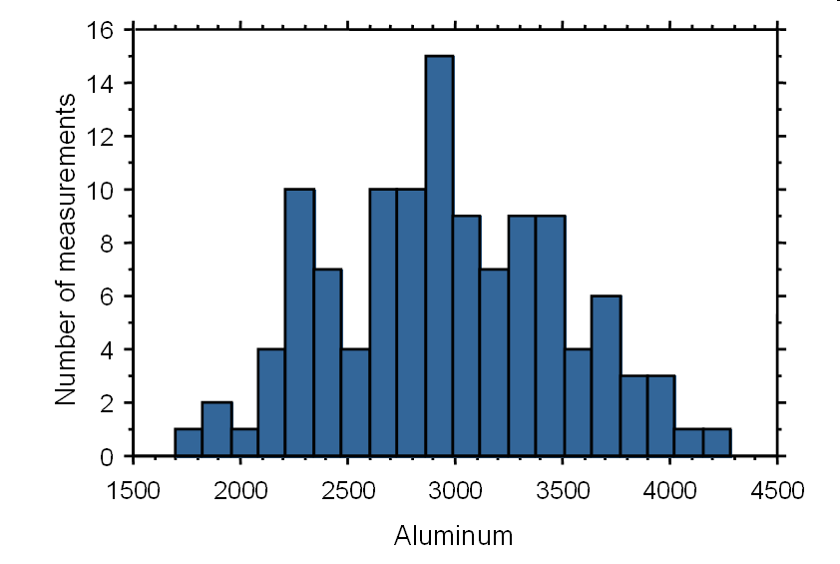
Sample Set Distribution
Random Sample Set:
Unbiased; But not Representative of Population
Environmental Sample Set:
Often Biased Toward Areas of Interest
Histogram
Biased,
Multiple Population?
Notes:
The sample set encompasses our knowledge of the population. The distribution of the sample values provides an estimate of true probability distribution of the population. A common method to depict the sample set distribution is a “histogram.”
For this purpose, the range of measured values in the sample set, i.e. the range of values from the minimum to the maximum measured value, is divided into a number of intervals or “bins”.
Histogram is plot of the number of measurements falling in each bin. If the number of measurements in each bin is divided by the total number of measurements, the histogram will depict the frequency of occurrence of sample values.
There are other graphical tools for depicting the sample set, which we will cover later on. At this stage we are interested on how the sample set information can be used to model and estimate statistical properties of the population.

Slide 21
Sample Distribution Model
Parametric – Fitted models
Non-Parametric – Sample set distribution, as is
Parametric
Non-Parametric
Notes:
Sample distribution models can be either parametric or non-parametric.
Parametric model is a known distribution that is fitted to the sample data. Such a model is stable, but not flexible. Sometimes, this model is called the underlying distribution.
Non-parametric model is the sample distribution without any modification – as is. This model is flexible, but unstable, i.e. can change each time you collect more data.
The choice of the modeling approach can impact the results of the analysis.

Slide 22
Estimates of Central Tendency
Sample mean:
is an estimate of μ
μ = True Population Mean
Sample median:
50% less than, 50% greater than
Sample Median is an estimate of the true population median
Underlying Assumption: Each observation is a random (unbiased) and independent representation of the population.
Caution:
Environmental data are rarely collected randomly. Also, often data collected near areas of interest exhibit correlation, i.e. not independent.
Notes:
Statistical properties of the true population can be estimated based on the sample set results. Among these the most important property is the “Central Tendency.”
Remember even when you were in primary school, the first question after each test was: “what is the average grade?” You intuitively knew that the average is an important indicator on how good you have done: above-average is good, below average is bad. In statistical jargon you where trying to determine the central tendency of the class grade.
In environmental site investigations, central tendencies are also very important. For example, the risk posed by a site is directly proportional to the average contaminant concentrations.
In environmental applications, the central tendency of a random variable is usually estimated by either “the mean” or “the median.”
The sample mean is just simply the arithmetic average of the sample set. Statisticians are careful to differentiate between the mean of the population and the sample mean. The sample mean is written as X-bar, while the population mean is written as the Greek letter “μ” (Mu). The Sample Mean is as an estimate of the population mean, μ.
The sample median is the middle value in the sample set, i.e. 50% of samples values are less than or equal to the sample median. The sample mean is also an estimate of the true population median.
The reliability of the sample mean and median as estimates of true population mean and median depends on: (1) the variability of sample values and (2) the number of measurements, n, which often referred to as the “sample size”.

Slide 23
Estimates of Sample Variability
Sample Standard Deviation:
s is an estimate of σ
σ = Standard Deviation of Population
Coefficient of variation:
Notes:
The variability of sample values are measured by their “standard deviation”.
The sample standard deviation is a measure of the spread of or dispersion within a set of sample values. The sample “variance” is the square of the sample standard deviation.
The sample standard deviation is calculated as the square root of the sum of the squared deviations of sample values from their average divided by one less than the sample size.
The sample standard deviation is given the symbol “s”, to differentiate it from the population standard deviation denoted by the Greek letter sigma (σ). The sample standard deviation is an estimate the true population standard deviation.
The sample coefficient of variation is the ratio of the sample standard deviation over the sample mean. Sample sets with coefficient of variations less than 1 have low variability.
As noted before, the reliability of the sample mean depends on the variability of the sample set. If the sample coefficient of variation is low, then a small representative sample set can yield a reliable average. In contrast, for sample sets with elevated coefficients of variation (say, greater than 1), large sample sizes may be needed before a reliable estimate of the mean can be made.

Slide 24
Accuracy of Estimate: Standard Error of the Mean
Data Variability: Sample Standard Deviation
Standard Error of Mean
Excel
=STDEV(cell array)
Excel
=STDEV(cell array)/SQRT(COUNT(cell array))
Notes:
To compute the standard error of the mean, we first need to calculate the sample standard deviation, which is the measure of sample data variability.
The histogram in this slide provides you with a visual depiction of sample data variability. In fact, the majority of data are at concentrations below 200 ppm, with few elevated concentrations in excess of 400 ppm. Note that this histogram doesn’t look like any theoretical distribution models that we saw earlier. Unfortunately, most of the time, our field data have histograms even more complicated that the one shown here. So how can we model our field data? This is another challenge that we always encounter in environmental applications. We will discuss in this challenge later.
Getting back to our example, the sample standard deviation is computed by summing the individual square deviations of each measurement from the sample mean, and then dividing the sum by the sample size -1. In this example, it yields a standard deviation of 155 ppm.
Try this in our Excel file (Example.xls) by typing: “=stdev(b2:b21)”.
Now, the precision of the sample mean is calculated as the ratio of the sample standard deviation over the squared sample size, which results in a standard error of 35 ppm. So we can say that our estimated sample mean is 181+35 ppm.
Try this in our Excel file by typing: “=stdev(be:b1)/sqrt(19)”

Slide 25
Confidence Interval (CI)
Confidence Interval is a range, about an “estimate”, which has a specified probability of containing the true population value.
For example, 95% confidence interval of the (sample) mean is a range of values which we are 95% confident that contains the true mean.
Significance (α) = 1 - confidence
For example, a 95% confidence corresponds to a 5% significance
Notes:
The sample mean or standard deviation, like any estimate is prone to uncertainty. Even when you have a large site-specific data set, you can never be 100% sure about your estimated exposure concentrations. Statistics recognizes this dilemma and provides procedures to quantify the uncertainty associated with the sample estimates.
In many instances, this uncertainty is quantified by a confidence interval. This is the range around an estimate that has a specified probability of containing its true population value.
The sample mean is an “estimate”, i.e. not a 100%-sure value of the true population mean. Confidence interval quantifies the range of values that contain the true population mean at a specified probability.
For example, a 95% confidence interval implies that we are 95% confident that this range contains the true population mean. This means that if we repeat sampling n measurements, 95% of time the sample mean falls within the computed confidence interval. In other words, 5% of time the sample mean falls outside the interval. This failure rate is referred to as the “significance”.
By definition, significance = 1 – confidence.

Slide 26
Confidence Limit (CL)
A Confidence Interval is bounded by an Upper Confidence Limit (UCL) and a Lower Confidence Limit (LCL).
UCL = Estimate + C₁
LCL = Estimate – C₂
C₁ and C₂ are similar to “safety factors” that increase, if the desired confidence ↑, the sample variability ↑, or the sample size ↓.
UCL and LCL are dependent on the (presumed) distribution of the estimate.
Notes:
The confidence interval is bounded by an upper and a lower confidence limit, which are usually referred to as UCL and LCL, respectively.
The range of deviations of UCL and LCL from the estimated value, i.e. C₁ and C₂ in this equation, can be viewed as “safety factors”, which are influenced by: the desired confidence; the sample variability; and the sample size. C₁ and C₂ increase if the desired confidence rises; the sample variability increases; or the sample size decreases. Remember that the UCL and LCL are dependent on the (presumed) distribution of the estimate.
EPA RAGS (Risk Assessment Guidance for Superfund – the Bible of risk assessors) defines the exposure concentration as the average concentration of the contaminant of concern. However, because this average is always calculated based on a sample set (i.e. it is not 100% error free), RAGS considers a safety factor, and thus, requires the use of the UCL of the mean, instead of the estimated mean.
In general, if our sample size is large and our sample variability is low, UCL will be close to the estimated mean. In contrast, small datasets with large sample variability entail large safety factors, i.e. UCLs that are much higher than the estimated mean.

Slide 27
UCL of the Mean Based on Central Limit Theory
Central Limit Theory: any sum of random variables tends to normality regardless of the distribution of its constituent random variables.
The sample mean of a large sample set (say n>30) with low variability (say CV<1) can be assumed to be normally distributed regardless of the distribution of sample values. Under this condition:
Source: RAGS….. (EPA 1989)
Notes:
We learned that it is easy to compute the UCL of the mean if our data are normally distributed. Now, how about skewed non-normal datasets?
Let me remind you that in almost all environmental applications, our site data are not normally distributed. In fact, I cannot recall a single sample data set from an impacted site that was normally distributed. Often site data have complicated histograms that don’t fit any of our typical distribution models. What do we do under these conditions?
Statisticians have provided a partial answer to our problem by the “Central Limit Theory,” which is one the few theories of statistics. According to this theory, any sum of random variable tends to normality regardless of its constituent random variables.
According to the Central Limit Theory, the sample mean, which is the sum of n sample values divided by n, also tends to normality regardless of the distribution of the samples values!
This tendency becomes strong as the number of samples increases, or the sample variability decreases. So as the number samples increases (say n>30), while the sample variability remains low (say CV<1), one can assume the sample mean is normally distributed regardless of the sample set distribution.
This is, however, only a partial answer. How about cases when we have limited data, or high variability? This leads us to other distributional assumptions about the sample mean.

Slide 28
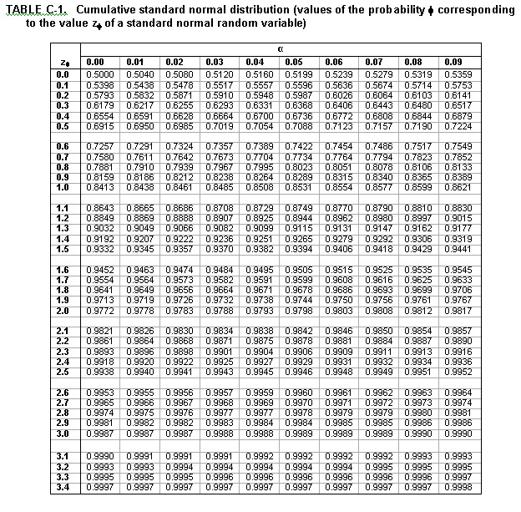
z_{50%} = 0.00
z_{80%} = 0.84
z_{90%} = 1.28
z_{95%} = 1.64
z_{99%} = 2.33
Excel
=NORMINV(prob, mean, st dev)
Z_{95%}
=NORMINV(0.95,0,1)
Notes:
Standard normal variate or “z” is either read from a table, or automatically provided by a software. Consider an old-fashioned standard normal variate table, which contains the cumulative probabilities of normal variates with a mean of zero and a unit standard deviation.
For example, to find out z_{95%}, first locate a cumulative probability closest to 0.95, that is “0.9495”. From this cell move to the cell in the first column and read the z_{95%} up to its first decimal, that is 1.6. The second decimal is provided in the cell along the first row above the “0.9495” cell, which is 0.04. So the z_{95%} is 1.6+0.04, or 1.64. 1.64 is a normal value which > than 95% of normal variates with a mean of 0 and standard deviation of 1.
I have also listed some other commonly used standard normal variates, such as z_{90%}. So if you multiply the standard error of the mean by 1.28, and add it to the sample mean, you will get the 90%UCL.
Almost every statistics text book has a standard normal variate table. In Excel software, the standard normal variate is obtained like by typing: “=norminv(.95,0,1)”, where 0.95 is confidence, 0 =mean, and 1 = standard deviation.
(Ask the participants to open their Excels and try this function.)

Slide 29
UCL of the Mean Normal, but Limited Data
If sample values are normal, but there are elevated uncertainty due to limited data (say n<30), Student’s t should be used as:
where, t_{95%,n-1} = Student’s t value with cumulative probability of 95% and n-1 degrees of freedom
Student’s t is more conservative in order to account for uncertainty in sample standard deviation due to limited data.
Excel
=TINV(two-tail sig, n-1)
t_{95%}, n = 10
=tinv(0.1,9) = 1.83
Notes:
In previous computations, we assumed that our sample standard deviation “s” is accurate and precise. However, if there are limited data, the sample standard deviation is prone to uncertainty. Student’s t takes this uncertainty into account and provides estimates of UCL which are more conservative.
“Student” was the pseudonym of Sir Ronald Aylmer Fisher, (1890–1962), the famed British eugenicist, evolutionary biologist, geneticist and statistician, who has been described as "The greatest of Darwin’s successors” and the “genius who almost single-handedly created the foundations for modern statistical science.” He, however, was quite humble, and always referred to himself simply as a “Student.”
Student’s t is especially applicable to sample sets with fewer than 30 measurements. Values of Student’s t values depends on the specified confidence and sample size, which is measured in term of its degrees of freedom, or sample size -1.
Student’s t can be obtained from tables, which are included in almost every statistics textbook, or provided by a software. In Excel, you can obtain t-values by typing “=tinv(.10,19)”, where .1 is the “two tail” significance, and 19 is the sample size -1.
Remember that in most environmental applications, we are only concerned about exceeding a standard, so our significances are usually “one-tail”, i.e. we don’t mind to be significantly below a standard, only when we are above it that worries us.
Converting two-tail to one-tail equivalent values is simple, because we are assuming a symmetric normal distribution. So the two-tail significance of 0.10 corresponds to a one-tail significance of 0.5, and a one-tail confidence of 0.95. So heretofore, the term confidence implies a “one-tail” confidence.
Now in Excel try “tinv” and “norminv” for 95% confidence levels for sample sizes of 10, 100, and 1000. Repeat the computations for a 90% confidence.
Student’s t is a conservative measure of the normal variate, and as we obtained more data, it approaches the normal variate. This is shown through an example in the next slide.

Slide 30
Normal “z” vs Student’s “t”
Standard normal z
Student’s t
Notes:
Now let’s consider an example. Two sample sets are considered with the same sample mean and standard deviations. As will be discussed later, due to the small CV<<1, we can assume that the sample mean of both sets are normally distributed.
The first one has 100 measurements (>>30), and thus, the normal variate can be used. This variate at 95% confidence is 1.64, resulting in a UCL of 153 ppm.
The second set has only 10 measurements. For this set, the Student’s t should be used to account for its limited sample size. The Student’s t at 95% confidence and with only 9 degrees of freedom, is 1.86. Note that this t value is 11% higher than its corresponding normal variate due to the limited sample size of the second set. The resulting UCL is further augmented due to the higher standard error, resulting in 162 ppm.
In the above example, the limited number of measurements in the second set led to an increase the UCL’s safety factor from 3 ppm for 100 measurements to 12 ppm for 10 measurements, a four-fold increase in the UCL safety factor.

Slide 31
Important Reminder: “Percentile” versus “UCL”
95% Percentile =449 ppm
Percentiles are associated with individual sample values
Typically used in background analysis
95% UCL of Mean = 241 ppm
UCLs are associated with estimated values
Typically used in risk assessment
436
5%
Excel
=PERCENTILE(cell range,0.95)
239
5%
Notes:
At this point, it very important to point out that 95%UCL and 95%Percentiles are not the same. But they are often confused.
Percentiles are associated with “individual” sample values. The 95% percentile represents the value of the individual measurement, which is greater than 95% of possible measurements. Percentiles are often used in in background analysis. In this example, for a random variable, assuming to be normally distributed, with a mean of 181 ppm and a standard deviation of 155 ppm, the 95%precdentile is 449 ppm.
Try this in Excel by typing “=percentile”.
In contrast, UCLs are associated with “estimated” values, such as the sample mean, which in this example is only 241 ppm. Do not confuse these two measures.
UCLs are typically used in risk assessment, because the level of risk is proportional to the “mass” of contaminants exposed to a receptor. “Mass” is directly related to the “mean” concentration, and not individual measurements. So RAGS requires the use of UCLs as a conservative measure of the computed average concentration.

Slide 32
Topics
Statistics in Environmental Applications
Statistical Modeling
Sample Statistics
Skewed Sample Data
Graphical Techniques
Hypothesis Testing
Field Challenges
Advanced Techniques
Notes:
All the methods that we have covered so far assume that the investigated data are normally distributed. However, in almost all cases, the histograms of our data resemble nothing like the bell-shape normal distribution. We now explore what options are provided by statisticians for such asymmetric “skewed” datasets.

Slide 33
Skewed Field Data
In almost all instances, site sample sets are not normally distributed
In many cases, the data are “skewed to the right” or “positively skewed”:
Few very high concentrations from highly impacted locations
Many samples from boundaries of the impacted areas to delineate the extent of impact
Few samples from not-impacted parts of the site
Notes:
In almost all instances, our site sample sets are not normally distributed.
In fact, in many cases, the data are “skewed to the right” or “positively skewed”:
Why is it like this? Could be that our data are “intrinsically” log-normal, or is it the result of our sampling approach? My experience points mostly to the latter option, i.e. our typical field sampling approach tends to generate positively skewed datasets:
Few very high concentrations from highly impacted locations
Many samples from boundaries of the impacted areas to delineate the extent of impact
Few samples from not-impacted parts of the site
Let’s now explore what options are available for such skewed datasets.

Slide 34
UCL of the Mean for Positively Skewed Data
If logarithm of measured values yield a symmetric histogram then the data can be viewed as log-normal
Notes:
As I noted, in many instances, site sample data are positively skewed.
Under such a condition, logarithms of the measured values will form a more symmetrical histogram.
Such datasets are usually viewed to be log-normally distributed.

Slide 35
Log-normal Model
x is lognormally distributed, if y = ln(x) is normally distributed
μ = population mean
σ = population standard deviation
f(x)
f(y)
Notes:
Lognormal random variable, x, is a variable whose logarithm, y, is normally distributed.
If we know the population mean and population standard deviation of y, we can then calculate the population mean and population standard deviation of x.

Slide 36
Log-normal Sample Data
If logarithms of measured values, y = ln(x), are normally distributed, then summary statistics of x can be estimated as:
Estimated mean of x
“Geometric” Mean of x or Median of x
Sample mean of y
“Geometric” standard deviation of x
Estimated standard deviation of x
Sample standard deviation of y
Notes:
For Sample statistics, if logarithms of measured values, y, are normally distributed, then statistics of x can be estimated as shown on this slide.
The “^” above μ of x and σ of x signify that these are estimates of the population mean and population standard deviation of x, respectively.
Geometric mean is the estimate of the population median of x. Note that the mean of x is much higher than the geometric mean of x. In fact, as variability of y increases, the difference between the mean and the median of x widens.
If s of y is 1, then the mean will be 60% higher than the median;
If s of y is 2, then the mean will be 7 times bigger than the median;
If s of y is 4, then the mean will be 3000 times bigger than the median!!!
So you can have a sample dataset with a very low median, but an extremely high mean.
This situation frustrates risk assessors, where presence of few high measurements, skews their site datasets, resulting in high mean concentrations.
Remember that in risk assessment the mean concentration is the appropriate parameter of interest. For example, in the soil digestion pathway, the “mass” of contaminants digested by a receptor = mean concentration in soil times the mass of digested soil.
So if the sample data are lognormally distributed with a high variability, then expect a large mean, and thus, an elevated risk, although the sample median can be very low.
Attempts to replace the mean concentration with the median concentration is misguided, because the median concentration times mass of soil digested does not yield the mass of digested contaminant. This product is a meaningless number that has nothing to do with the mass of contaminants that is digested by the receptor.

Slide 37
Log-Normal Distribution
Different lognormal distributions
1.6
1.2
Low Variability
Nearly Symmetric
0.8
High Variability
Highly Skewed
0.4
0.0
0
10
20
30
40
Notes:
The difference between the mean and the median of a lognormally distributed depends on its variability.
So if data variability is low, then the lognormal model becomes nearly symmetric, i.e. a normal distribution where the mean = the median.
In contrast, higher variability leads to more skewed models, and thus, extremely high mean values.
The question that should be raised is: Why can a sample dataset have a moderate median, but an extremely high concentration? Could the few high concentrations responsible for the skewed data belong to a different population? Is it appropriate to mix these anomalous values with the rest of the data? This will be the topic of our second exercise.

Slide 38
UCL of the Mean Log-normal Data
If measured values are log-normally distributed, then their logarithms are normally distributed, and so
where
= sample mean of logarithms of measured values
= sample standard deviation of logarithms of measured values
H_{95%} = H-statistic with a cumulative probability of 95%; a function of n and s_{ln x}
From EPA Calculating the Upper Confidence Limits for Exposure Point Concentrations at Hazardous Waste Sites, Dec 2002
Notes:
So far we covered procedures to compute the mean of a lognormally distributed variable. Remember that in environmental applications, we always need the conservative measure of mean, i.e. the UCL of the mean.
This equation shows how we can calculate the 95%UCL of the mean of a lognormally distributed variable.
Values of H-statistics for a range of sample sizes and sample standard deviations are given in the Excel file “H95% Values.xls”
Let’s look at few examples of UCL calculations.

Slide 39
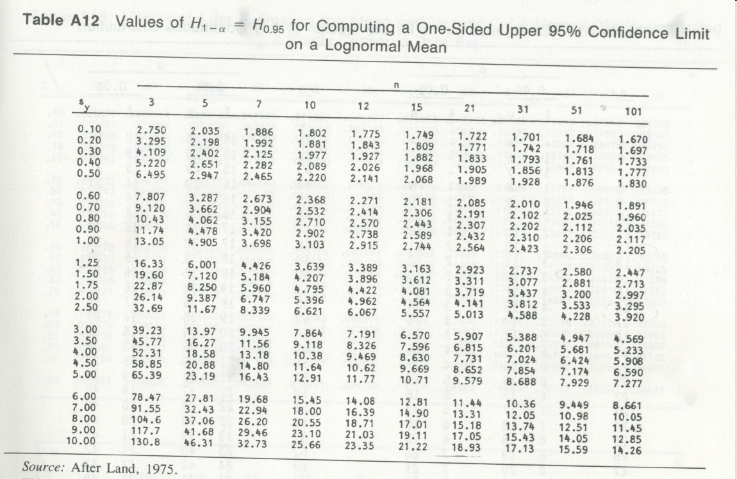
Source: Gilbert, R. O. “Statistical Methods for Environmental Pollution Monitoring,” Van Nostrand Reinhold, New York, 1987.
Notes:
H-statistics table for 95%UCL calculation. Gilbert (1987) also contains H-statistics for 90% UCL.

Slide 40
Example (Lead Histogram)
Sample Mean = 4,419 + 1,760 ppm
Sample Median = 14 ppm
Estimated Mean = 73,986 ppm
Estimated Median (GM) = 23 ppm
Using log sample mean and standard deviation
Notes:
Lead histogram versus histogram of Ln(lead)
The lead data are highly skewed ranging from 0.01 to 100,000 ppm.
Note that the estimated mean based on log-normality is an order of magnitude larger than the computed sample mean. This difference is due to the fact that the lognormal estimates assume that our sample set contains a continuous range of observations from 0.01 to 100,000 ppm. While in reaility, you see many gaps when you go beyond 500 ppm. As a result, your sample mean is 4419 ppm, while the “estimated population mean” is 75350 ppm.
Also note that the estimated population mean is nearly three orders of magnitude larger than the estimated median or geometric mean. This is due to the enormous variability of the log transformed data with a sample standard deviation of 4.025.
Do you seen anything wrong with the log estimates?
Is it reasonable to assume that the entire range of lead concentrations from 0.01 to 100,000 ppm, which is 10% lead, are from a single population? If not, what could be the explanation?
If you were a regulators, which estimate of the mean did you prefer?
(Open Discussion)

Slide 41
Example (Answer)
95%UCL of Lead = 7,314 ppm (z)
= 7,341 ppm (t)
= 612,796 ppm (H)
“Why such a large discrepancy?”
Notes:
Here are the results. Please note the enormous UCL based on the H-statistics. This value is orders of magnitude larger than the normal and Student's t estimates.
The H-UCL is nearly 20 times larger than the 95%-tile. This is clearly a counter-intuitive answer. Because we always expect, the individual measurements to be more variable that their sample mean, so the 95%-tile should always be greater than the 95%UCL.
These big differences are all attributable to assumed continuous range of data from 0.01 to 100000 ppm (i.e., assuming no gap) and the large variability of log-transformed data.
As I noted before, it is highly unreasonable to assume that this variable dataset comes form a single population. Instead, it is the result of mixing background and impacted populations.
Mixing of populations yields often yield over-conservative results. This is a field challenge that we will discuss later on.

Slide 42
Modeling Discrepancy
Sample Mean = 4,419 + 1,760 ppm
Estimated Mean = 75,350 ppm
Estimated Median (GM) = 23 ppm
Notes:
One reason for the discrepancy is due to the poor fit of log-normal distribution even when the data is skewed. So remember: skewness does not always imply log-normality.
(Open Discussion)

Slide 43
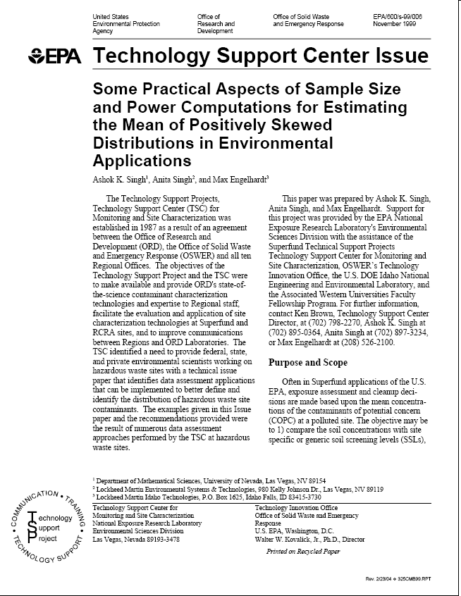
Problem with Log-Normal Results
Incorrect modeling of mixed data as log-normal
Small skewed dataset ⇨ meaningless results
Notes:
Singh et al. (1999) explain a number of problems with log-normal distribution.

Slide 44
UCL of the Mean: Other Alternatives
EPA’s Pro-UCL (EPA, 2011):
UCL of the Mean Based Upon Student’s-t Statistic
UCL of the Mean of a Gamma, G(k,2) Distribution
UCL of the Mean Based Upon H-Statistic (H-UCL)
UCL of the Mean Based Upon Modified-t Statistic for Asymmetrical Populations
UCL of the Mean Based Upon the Central Limit Theorem
UCL of the Mean Based Upon the “Adjusted” Central Limit Theorem
UCL of the Mean Based Upon the Chebyshev Theorem
UCL of the Mean of a Lognormal Population Based Upon the Chebyshev Theorem
UCL of the Mean Using the Jackknife and Bootstrap Methods
Users’ Guide and Software:
http://www.epa.gov/osp/hstl/tsc/software.htm
Notes:
Heretofore we have only looked at two methods to calculate UCLs. There are many more methods. EPA’s Pro-UCL provides a good description of a number of other UCL computational procedures, as listed here.
You can download the Pro-UCL users’ guide and software for free. This software reads from a spreadsheet and gives you the entire list of UCLs, and also recommends which UCL estimate is more reliable!
The revised EPA’s Supplemental Guidance to RAGS, “Calculating the Upper Confidence Limits for Exposure Point Concentrations at Hazardous Waste Sites”, dated December 2002 recommends the use of Pro-UCL.
Just as a note: the authors of Pro-UCL strongly believe that H-statistics is flawed, and should not be used when dealing with highly variable datasets.
I highly recommend reading the Pro-UCL document, which gives a thorough explanation on the underlying assumptions of various UCL methods.
The source and users’ guide can be downloaded at these addresses.

Slide 45
Topics
Statistics in Environmental Applications
Statistical Modeling
Sample Statistics
Skewed Sample Data
Graphical Techniques
Hypothesis Testing
Field Challenges
Advanced Techniques
Notes:
So far, we have focused on the central tendency of the sample set, which plays an important role in environmental applications, especially in risk assessment. Now, we are going to explore other aspects of the sample set, and for this purpose, we use a variety of graphical techniques.

Slide 46
Use Graphical techniques to Visualize Sample Distribution
Histograms
Box Plots
Probability Plots
Notes:
Graphical methods are useful for describing sample sets to determine their statistical properties, such as:
Sample set distribution shape (symmetric, skewed, bi-modal, etc.)
Type of distribution (normal, log-normal, etc.)
Central tendency (mean, median and mode)
Variability (dispersion)
Data Range, Extreme values (outliers)
Symmetry (skewness)
Graphical methods are used to get a visual grasp of the data, i.e., to visualize where the central tendency of the data set is located and the variability in the data, to compare the central tendency with extreme data values, to visualize the shape and location of the model probability density function, and to look for trends and patterns in data.
Data analysis without visualization is like flying blind – and should be done before looking at the descriptive summary statistics.

Slide 47
Histogram
16
Histogram depicts the distribution using “binned” data plotted against relative frequency of occurrence
14
12
10
8
Number of measurements
6
4
2
0
1500
2000
2500
3000
3500
4000
4500
Aluminum
Notes:
Histogram is probably the best known exploratory graphical tool in use.
A histogram summarizes the data by grouping them into intervals, and then plotting the number of occurrences in each interval or “bin”.
In this plot, the range of soil aluminum concentrations are divided into 100-ppm intervals. Each bar then depicts the number of samples measured in specified interval. For example, there 15 soil samples with aluminum concentration of between 2900 to 3000 ppm.
Let’s look at this graph, and see whether we can answer the following questions:
What are the range of measured values? (1700 to 4300 ppm)
Are the data more-or-less symmetrically distributed? (Yes)
Where is the central tendency of the sample data? (approximately 3000 ppm)?
Are the mean, median or mode similar to each other? (Yes)
Are there any obvious outliers? (No)
So as you see, plenty of information can be extracted from a histogram.

Slide 48
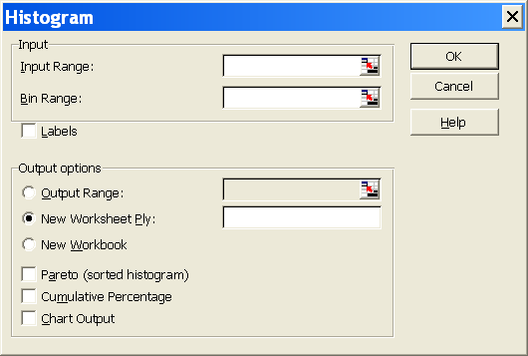
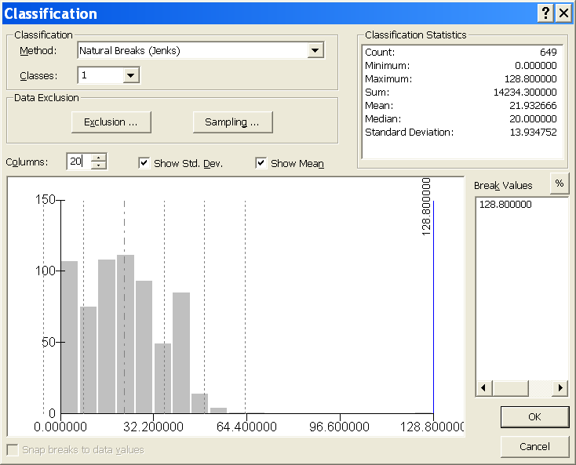
Creating Histograms
Excel offers manual histogram construction which is prone to misuse.
ArcGIS (Properties> Symbology> Show Quantities> Classify) is better.
Notes:
Notes about building a histogram.

Slide 49
Box plot; “Box-and-whisker” plot
Simple box: whiskers extend to minimum/maximum
Standard box: whiskers extend to one step
Step = 1.5 times interquantile range
Good way to show variability and skewness
Outliers or outside values
Standard Box Plot
Largest measurement within 1 step above box
75th percentile
X
Mean
Interquantile Range
Median
25th percentile
Smallest measurement within 1 step below box
Notes:
A simpler version of the histogram is the so-called “box and whisker plot” of the “box plot”.
The box plot summarizes data by showing 6 numbers, that are: the minimum, the 25%-tile, the median, the mean, the 75%-tile, and the maximum.
The interquartile range is the distance between the 75th percentile and the 25th percentile.
The whiskers of the box plot usually stop at 1.5 times the interquartile range to highlight possible outliers, which are shown as dots.
The box plot is especially helpful for indicating whether a distribution is skewed and whether there are any unusual observations (outliers) in the data set.

Slide 50
Typical box plots
Normally Distributed Data
Mean ≅ Median
Outside values ≅ Upper and lower 1 percentiles
Interquantile range ≅ 1.5 standard deviations
Lognormally Distributed Data
Mean > Median
Upper whisker > Lower whisker
Outside values ≅ Maximum measurement
X
X
Notes:
These box plots show a normal distribution versus a log normal distribution.
They are good examples of how the plots graphically portray the main features of the sample distributions. The box plot on the left is for a normal dataset. This plot is symmetrical, and the mean equals the median.
The box plot on the right is for a positively skewed lognormal dataset. Notice that the mean is greater than the median.

Slide 51
Multiple Box and Whisker Plots
A simple way to compare data sets to each other or
to background or a standard
Standard
x
Data Values
x
x
x
x
x
1 2 3 4 5 6
Zones
Notes:
In many cases, multiple box plots can provide an excellent way to compare different datasets. For this purpose, multiple box plots can be placed on a single graph to quickly assess the differences in the datasets collected in different geographical regions or time periods, etc.
These plots are also useful for comparing data sets to a set of applicable background data.

Slide 52
Probability Plots
Plot of observed data vs. expected values based on a specified distribution model
Uses:
Check if the sample set fits a specified probability model
Identify outliers
Determine if the data set consists of a single or multiple populations
Different Types of Probability Plots:
Normal Probability Graph Papers
P-P Plots
Q-Q Plots
Notes:
Another effective way to visually assess the sample set distribution is the probability plot.
Probability plots depict observed data vs. their expected values or probabilities based on specified distribution models
Probability plots are used for:
Check if the sample set fits a specified probability model
Identify outliers
Determine if the data set consists of a single or multiple populations
There are different Types of Probability Plots, including:
Normal Probability Graph Papers
Probability-Probability or P-P Plots
Quantile-Quantile or Q-Q Plots
We now explore these types of probability plots.

Slide 53
Probability Plots
Plot ranked data (ascending) vs. their observed cumulative probability (rank divided by sample size + 1) on a normal probability graph
If linear-scale Y-axis → normal
If log-scale Y-axis →log-normal
If plotted points form a straight line, then the specified model is a good fit
Notes:
This is the old fashioned probability plot that requires a special graph paper. Nowadays with the advent of statistical software, the normal graph papers are less used. The process is easy:
Plot ranked data (ascending) vs. their observed cumulative probability (rank divided by sample size + 1) on a “normal” probability graph.
The X-axis of this plot shows cumulative probabilities consistent with a normal distribution: 50% is at the center, and as we move toward the tails, we approach, 0% and 100% at a diminishing rate – just like the bell shape of the normal distribution.
If we use a linear-scale Y-axis, then the graph is assuming a normal distribution.
If we use a log-scale Y-axis, then the graph is assuming a log-normal distribution.
If plotted points form a straight line, then the specified model is a good fit.
In this example, the top plot is a poor fit, because it dies not form a straight line. The bottom plot, however, is a good fit. This plot has a log-scale Y-axis, and thus, the data is log-normal.
The normal graphs are only limited to normal and log-normal models. Other probability plots, however, can be easily applied to a variety of distributions.

Slide 54
Determining the Type of Distribution and Outliers
Outlier?
Conclusion: Lead data are log-normally distributed with a possible outlier.
In statistics, outliers are often discarded. In environmental applications, outliers are often the main target of the investigation and must not be discarded.
Notes:
Let’s now look at the applications of probability plots.
In this slide we use Q-Q plots to determine the probability distribution of lead data in Exercise 1.
Conclusion: lead data are log-normally distributed. There is also a possible outlier.

Slide 55
Determining Single v. Multiple Populations
Segmented straight lines
Inflection point ≅ population separation value
Inflection point can help separate background from contamination
Plotted with Sigma Plot 6.1
Notes:
Probability plots also use multiple populations by yielding segmented and gaped plots.
Here we see 3 distinct populations represented by three separate straight lines with distinct changes in the slope.
This graphical tool is used in background analysis to distinguish a natural or manmade background constituent from a release.

Slide 56
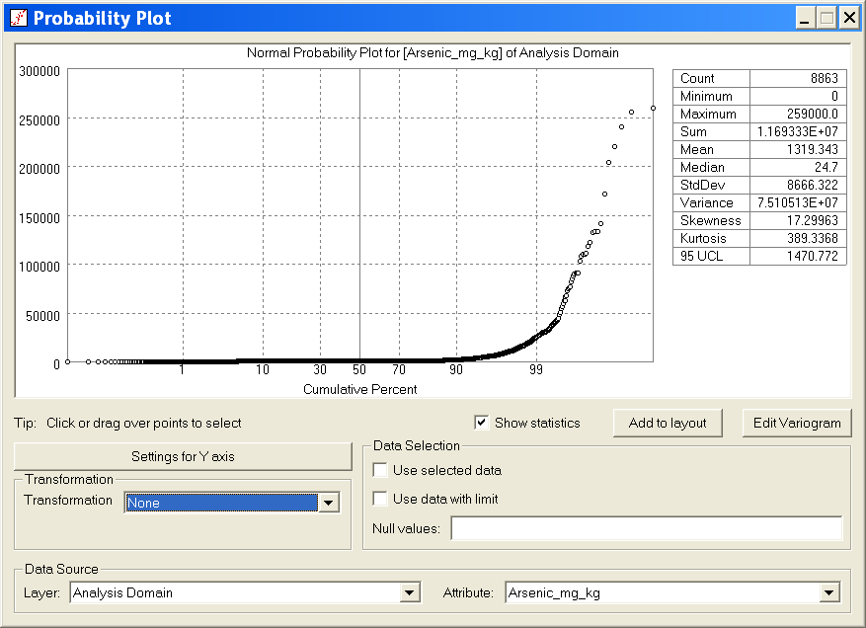
NewFields ArcGIS (NF_Geostat)
Notes:
NewFields ArcGIS application (NF_Geostat) offers normal and log-normal probability plots.

Slide 57
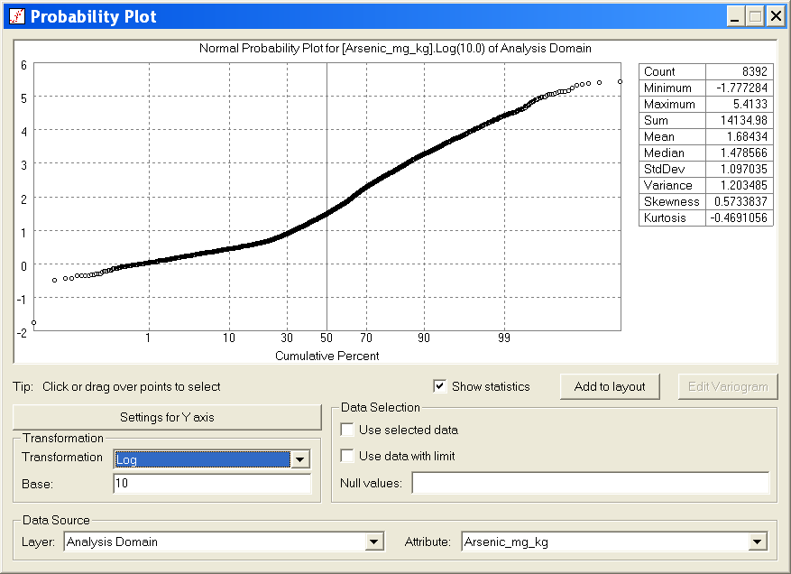
NewFields ArcGIS (NF_Geostat)
Notes:
NewFields ArcGIS application (NF_Geostat) offers normal and log-normal probability plots.

Slide 58
Topics
Statistics in Environmental Applications
Statistical Modeling
Sample Statistics
Skewed Sample Data
Graphical Techniques
Hypothesis Testing
Field Challenges
Advanced Techniques
Notes:
In many cases, statistics can help us to answer certain types of questions. If the answers to these questions are of a “yes-no” type, then hypothesis testing may be applicable, which is the next topic.

Slide 59
Hypothesis Testing
Why use it? To aid in decision making, e.g.:
Is the site contaminated?
Are site data significantly higher than the background?
Is there a declining trend in the groundwater data time series over time?
What are the advantages?
Quantitative; Consistent; and Repeatable
Notes:
Why do we use hypothesis testing? In environmental applications, there are many instances that we have to make a decision based on a yes or no to a specific question. For example:
Before computing the exposure concentration, we are faced with a question: Are sample data normally distributed?
Are site data significantly higher than the background? Is the site impacted or simply part of background condition?
Is there a trend in the groundwater data time series over time? Is there a release or not?
Did a groundwater treatment system reduce groundwater pollution levels? Is the pump-and-treat system effective or just a waste of time-and-money?
All these questions may be answered through hypothesis testing. The main advantages of these tests are: (1) they are quantitative; (2) they are consistent, and (3) they are repeatable. So others can reach the same conclusion, if they repeat the process.

Slide 60
Hypothesis Testing
Provides a yes-no answer to a specific question.
Examples:
Is the site contaminated or clean? Yes or No?
Are site data greater than background? Yes or No?
Takes into account the
Variability of data
Uncertainty of statistical estimates (e.g., sample means, variances, proportions, distributions, trends)
Notes:
Hypothesis testing provides a yes-no answer to a specific question.
Examples:
Are sample data normal? Yes or No?
Are site data greater than background? Yes or No?
Hypothesis testing takes into account the: Variability of data; and Uncertainty of statistical estimates (e.g., sample means, variances, proportions, distributions, trends)

Slide 61
Null and Alternative Hypotheses
Null hypothesis (H_{o}):
A statement that is driven by our site knowledge or defined by regulations
Hypothesis testing is geared toward rejecting the null hypothesis
Example: Site is contaminated
Alternative hypothesis (H_{a}):
The opposite of the null hypothesis
Example: Site is clean
Notes:
Before you conduct a test, you need to define your null hypothesis. The null hypothesis or Ho is a statement that is consistent with your current state of knowledge. In environmental applications, this knowledge is referred to as the “site knowledge”.
Ho is not be an arbitrary choice. It must reflect your site knowledge.
Without an adequate site knowledge, testing of a null hypothesis is useless.
Hypothesis testing is geared toward rejecting the null hypothesis
Example: Chemical X in Site Y is background
The alternative hypothesis or Ha is the opposite of the null hypothesis.
If Ho is rejected, then Ha must be adopted.
Example: Chemical X in Site Y is a COPC.

Slide 62
Example of Hypothesis Testing: Attainment of Cleanup Goals
EPA 1989 Guidance
U.S. EPA, Statistical Methods for Evaluating the Attainment of Cleanup Standards, Vol. 1: Soils and Solid Media. EPA 230/02-89-042. Washington, DC: Office of Policy, Planning, and Evaluation. 1989.
Null Hypothesis H_{o}: Site is Contaminated
Reject H_{o}, if 95%UCL<C_{s}
“Reject-Support” or RS Testing
Notes:
Next few pages cover a common example of hypothesis testing, i.e. evaluating the attainment of cleanup standards.

Slide 63
Decision Errors and Test Power
Decision Based on Data
Site is
Contaminated
“H_{o}”
Site is
Clean
“H_{a}”
Site is Contaminated
Correct:
Confidence
Type I Error:
False Positive
α
True
State
Site is
Clean
Type II Error:
False Negative
β
Correct
(Test Power)
Notes:
True State are the actual conditions, such as Site is clean. Our decisions are based on our sample data. So we can make two errors: Type I and Type II with likelihood of α and β, respectively.
A good test is a test whose sum of these error are minimized.
Note that sometimes you may get tempted to design a test that favors one error over another. But there is no trade off between these errors, i.e. you cannot design a reliable test that favors α over β, or vice-versa.
For example, imagine that we set α=0.0001%. This means that the difference between our site mean concentration must very large before we call the site contaminated.
Some people may prefer such results, but the problem is that under this scheme, there will a very high likelihood that truly impacted sites will go unnoticed. So this test is inherently flawed and unreliable.
In summary, a good test has a minimum α+β. In contrast, a test that has a large α or β is inherently unreliable, and should be avoided at all cost.

Slide 64
Significance and Confidence
α = False Positive = Type I Error
Probability of incorrectly rejecting the null hypothesis
Also known as “significance level”
Always defined by convention to be 10, 5, or 1%
1- α = Confidence
β = False Negative = Type II Error
Probability of incorrectly not-rejecting (accepting) the null hypothesis
Usually selected to be higher than α, such as 10 or 20%
Power = 100% – β
Probability of correctly rejecting the null hypothesis
Notes:
Remember that in a hypothesis test, you either reject or not-reject a null hypothesis. The significance and confidence of any hypothesis tests is directly related to the type of errors that can be made.
α = False Positive = Type I Error; This is the probability of incorrectly rejecting the null hypothesis. Also known as “significance level.” The tolerable level of false positive is always defined by convention to be 10, 5, or 1%.
This is an error that you are willing to make in order to ensure the conservative nature of your analysis. 1-α is defined as “confidence”.
β = False Negative = Type II Error; This is the probability of incorrectly not-rejecting (accepting) the null hypothesis. This is the error that regulators are especially concerned about.
In cases, where small β requires an infeasible number of samples, it is set at higher rate than α, such as 10 or 20%
Test Power = 100% – β; This is the probability of correctly rejecting the null hypothesis.
Next slide shows these errors in a graphical manner.

Slide 65
Sample Size and Test Power
More measurements are needed, as:
α ⇓ = Confidence ⇑
β ⇓ = Power ⇑
Test resolution ⇑ = Minimum detectable difference for correctly rejecting the null hypothesis at the given Power ⇓
Example: You want to be 90% sure that you will identify a COPC, if its site mean concentration is more than 15% greater than its background mean concentration
Notes:
For a reliable test, more measurements are required, if:
Its Type I error or significance decreases (In other words, its confidence increases)
Its Type II error decreases (in other words, its power increases)
Test power is related to the desired resolution of the test, i.e. the “Minimum detectable difference for correctly rejecting the null hypothesis”
Example: You want to be 90% sure that you will identify a COPC, if its site mean concentration is more than 15% greater than its background mean concentration

Slide 66
Null Hypothesis
Null Hypothesis (H_{o})
μ > C_{s}
Reject H_{o}, if
False Positive
“α”
Type I Error
Incorrectly rejecting the null hypothesis
Site is declared clean, when it is contaminated
X
Mean
Concentration

Slide 67
Power
P = 1-β
Correctly rejecting the null hypothesis
The Site is declared clean, when it is clean
Alternative Hypothesis
μ₁<C_{s}
False Negative
“β”
Type II Error
Incorrectly accepting the null hypothesis
The Site is declared contaminated, when it is clean
X
Mean
Concentration

Slide 68
Alternative Hypothesis
μ₁
Null Hypothesis
C_{s}
X
β
α
Mean
Concentration

Slide 69
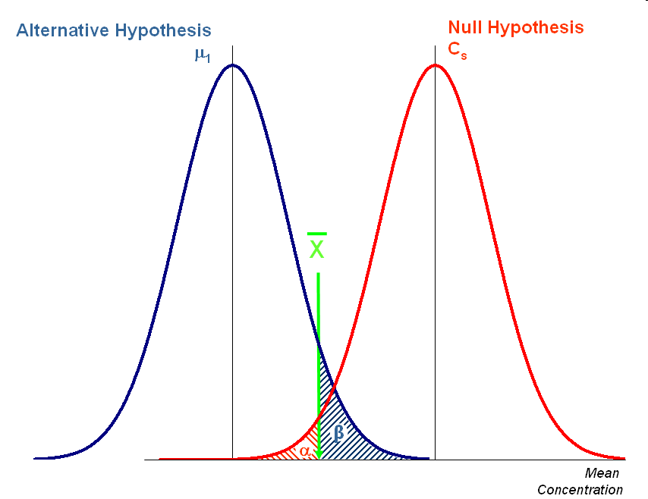
A priori or “Statistical” Sample Plans (Assumptions and Limitations)
Notes:
The hypothesis test structure can be used to determine the minimum number of samples necessary to achieve a pre-determined α and β.
As EPA technical document (Singh et al. 1999) indicates: “It is very well possible that it may not be feasible to achieve the desired performance parameters without taking an enormous number of samples. This is especially true when a lognormal model is assumed. Therefore, it becomes necessary to find a balance between the choice of performance parameters (error rates, power) and the number of samples needed for hypothesis testing. For example, when more (or less) samples are taken, then the gain (or loss) in levels of performance standards for the various approximate formulas need to be investigated. Keeping some of these practical considerations in mind, the regulators may have to settle for reduced values of performance standards.”

Slide 70
Alternative Hypothesis
μ₁
Null Hypothesis
C_{s}
Fewer Measurements ⇨ Higher Standard Deviation ⇨
Both α and β rise
X
β
β
α
α
Mean
Concentration

Slide 71
Avoiding Limitations: Use non-parametric tests
Parametric tests:
The test variable is assumed to have a known distribution
Example: Student’s t-test assumes that the mean concentration is normally distributed.
Non-parametric tests:
No specific distribution is assumed for the test variable
Example: Slippage test does not assume any specific distribution for the number of site measurements greater than the maximum background concentration.
Notes:
Tests can also be divided based on their underlying assumptions.

Slide 72
Other Common Tests (1)
Correlation tests
Parametric: Pearson’s r test
Regression Analysis
Strong & Significant
Linear Relationship
Strong & Insignificant
Linear Relationship
Notes:
Other common tests evaluate the presence of a possible relationship between two variables.
These tests are not designed to determine cause-effect, instead they can be used to confirm or reject a cause-effect hypothesis.
Insignificant correlations can yield misleading results.
Thorough examination of bivariate plots are highly recommended before conducting such tests.

Slide 73
Other Common Tests (2)
Correlation tests
Non-Parametric: Kendall τ test
Strong & Significant
Non-linear Relationship
Misleading Results
Notes:
Non-parametric tests are designed to assess non-linear relationship. These tests are rank-based, which can yield misleading results.
Thorough examination of bivariate plots are highly recommended before conducting such tests.

Slide 74
Other Common Tests (3)
Groundwater Release Tests:
Are downgradient and upgradient well samples have the same mean concentrations (i.e. no release)?
m_{down}; n_{down} = mean concentration and number of measurements in the downgradient (compliance) well
m_{up}; n_{up} = mean concentration and number of measurements in the upgradient (background) well
s = pooled sample standard deviation
Two-sample t Test: Null hypothesis is rejected, if test t > t_{95%.}
Source: Statistical Analysis of Ground-water Monitoring Data at RCRA Facilities (EPA 1989)
Notes:
Another group of common hypothesis test address the following important groundwater monitoring issue:
Is there a groundwater release at a site?
Situation: In absence of any information regarding a release, the null hypothesis is: “Downgradient and upgradient well samples have the same mean concentrations (i.e. no release).
For this purpose, the two-sample t test can be used, especially if long time series are available, and if our site knowledge indicate an absence of release
Under this condition, the null hypothesis if the downgradient and the upgradient wells are similar, and thus, the null hypothesis is rejected, if test t > t95%.

Slide 75
Other Common Tests (4)
SITE DATA
32
28
26
22
17
16
16
14
12
11
8
6
6
5
4
4
ND
ND
ND
BG DATA
30
29
27
26
22
14
9
8
6
5
5
5
4
4
3
3
2
ND
ND
Site Data
10
20
30
Statistical Test
BG Data
?
10
20
30

Slide 76
Two-sample Tests
Suspect Difference | Test | Comparison | Type
Uniform Difference | Wilcoxon Rank Sum (WRS) | Median | Non-parametric
 | Gehan | Median | Non-parametric
 | Student’s two-sample t-test | Mean | Parametric
 | Satterthwaite t-test | Mean | Parametric
Tail Difference | Slippage | High concentrations | Non-parametric
 | Quantile | High concentrations | Non-parametric
 | Two-sample test of proportions | Percent of measurements above a given cutoff | Non-parametric

Slide 77

Site v Background Tests
NAVFAC Guidance Documents, Section 4
Test type depends on:
Impact hypothesis
Site-wide
Localized
Parametric v. non-parametric procedures
<http://enviro.nfesc.navy.mil/erb/restoration/methodologies/main.htm#DE>
Notes:
NAVFAC provides a comprehensive guidance for background analysis.

Slide 78
Flawed Tests (Tests with Excessive Error) Example: The so-called “Background Threshold Test” Does an individual sample exceed background concentrations?
SAMPLE
32
BG DATA
30
29
27
26
22
14
9
8
6
5
5
5
4
4
3
3
2
ND
ND
BG Data
Comparison
?
10
20
30
Notes:
Not all hypothesis tests are reliable. In fact, some of the ones used in environmental applications are quite flawed.
An example include the so-called “background threshold test.” In this test, every single measurement is compared to the background threshold value (usually the top 5% of background data are ignored, so they use the 95%-tile value as background threshold).
Then if a single measurement exceeds the background threshold test, the chemical is viewed as a COPC.
If you are dealing with a single measurement, then there is 5% chance that you incorrectly identify a chemical as a COPC. In many cases, this level of error is tolerable, i.e. ensures the conservative nature of our decisions. However, as the number of site measurements increases, this error rate rises.

Slide 79
Individual comparisons have very high “false positive” rates
False Positive Rate
Chances of having at least one exceedance above 95% value when both site and background are from the sample population
Number of Comparisons | False Positive Rate (%)
1 | 5%
2 | 10%
3 | 14%
4 | 19%
5 | 23%
10 | 40%
20 | 64%
30 | 79%
40 | 87%
50 | 92%
80 | 98%
90 | 99%
100 | 99.4%
Background Threshold Test
Compare individual site measurements to some threshold value calculated from background to distinguish COPCs vs. background chemicals
Flawed Approach:
Excessive likelihood of reporting exceedance even when site data = background!
Notes:
In fact, as shown in this table, by the time you have 30 or more site measurements the threshold test yields nearly 80% chance of Type I error.
In other words, if you have 30 site measurements, there is an 80% chance that at least one of them exceed the background threshold, even if both sample sets come from the same population.
By the time you have 60 site measurements (a very common situation), this error rate approaches 95%.
This means that the conclusion of this test is almost pre-determined. This is not really a test; it is a guaranteed condemnation. Such flawed test should be avoided at all cost.

Slide 80
Topics
Statistics in Environmental Applications
Statistical Modeling
Sample Statistics
Skewed Sample Data
Graphical Techniques
Hypothesis Testing
Field Challenges
Advanced Techniques
Notes:
Our last topic is probably as important as all the other topics combined. So far we have talked about ideal cases, with occasional hints that our field data may be inconsistent with the underlying assumptions of our statistical tools.
I refer to these inconsistencies as our “field challenges”. We especially need to understand the practical implications of these challenges.

Slide 81
Field Challenges
Typical field data:
Biased toward impacted zones = Non-random
Clustered around impacted spots
Correlated due to release patterns
Clean + Impacted Populations
Laboratory uncertainty, plus numerous non-detects
Ideal data set:
Random samples
Unclustered data
Uncorrelated data
Representing a single population
Known values with no measurement errors
Notes:
Our “field challenges” stem from the fact that statistical techniques are based on the assumption that our sample set is an ideal and representative dataset, i.e.
Random samples (free of any bias toward a specific portion of the site)
Unclustered data (there are no undue clustering – over-presentation of repetitive data)
Uncorrelated data (the measurements are uncorrelated, so each sample contains an equal amount of “new” information)
Representing a single population (the investigated variable can be modeled as a single population)
Known values with no measurement errors (every measurement is a unique values free of any error)
Unfortunately, none of these conditions are met by our field data:
Our data are always biased toward impacted zones = Non-random
They are always clustered around impacted spots
In many instances, due to release patterns, our data are correlated
We always have a mixture of clean + impacted samples
and there are always laboratory uncertainty, plus numerous non-detects
The questions that immediately arises are:
What are the effects of these inconsistencies?
Are the results of statistical analyses reliable?
Are we producing over-conservative results based on computational artifacts?
What can we do to minimize the effects of these computation artifacts?

Slide 82
Ideal Statistical Samples
Random Sample are devoid of any bias toward a specific portion or portions of the population
Random
Samples
Notes:
In environmental site investigations, we do not have full knowledge of our population. Instead, all our decisions (i.e. inferences) are made based on our sample estimates. So it is very important to understand the significance of the sampling policy.
Statistics tells us that we need representative samples that give us an unbiased picture of the investigated variable.
It is precisely for this reason that statisticians always prefer “random samples” – samples that are devoid of any bias to any specific portion or portions of the population.
Consider the case of a pollster that calls about a 1000 people to survey public opinion. To ensure representativeness of the samples, the pollster usually randomly generates phone numbers to call. The 1000 answers to the same question then form a basis to evaluate public opinion. This is an example of random sampling process.
Consider now the case of a “lazy” pollster who abandons the random calling process, and instead, repeatedly calls few numbers. We intuitively know that repeated answers from few households are worthless because the samples are biased to the targeted households.
Unfortunately, in environmental applications, that is exactly what we do by focusing on sampling impacted portions of the site.
So what are the effects of such sampling on our statistical estimates?

Slide 83

Field Challenges
Environmental site samples are rarely random; driven by site history and knowledge
Potentially
Impacted
Random Samples
Site History
Biased Samples
Professional Judgment
Purposeful
Notes:
Let’s look at this problem through an example.
Statistical approaches demand an unbiased, representative sample set, i.e. random sampling.
In environmental site investigations, samples are rarely random. In fact, the choice of sampling locations are dependent on our site history and knowledge.
The resulting samples are often biased, clustered, and correlated toward locations of historical impacts.
In general, we usually collect few samples from the highest impacted locations; many samples from impact boundary locations; followed by relatively small number of samples from the clean portions of the site.
This type of biased sampling is driven by:
(a) economic factors (limited budget forces us to focus on critical zones); and
(b) regulatory preferences (stakeholders are only interested in the extent of impact)
Let’s investigate the effects of this type of sampling on a common statistical inference, i.e. calculating mean and UCL.

Slide 84
Example
A typical biased soil sampling is conducted.
Total Site = 10 acres
Impacted = 1.5 acres
99
130
45
47
35
166
169
300
57
200
650
156
127
74
250
320
444
40
24
77
Impacted Zone
Notes:
Given: A typical biased soil sampling is conducted. The site is 10 acres, where about 1.5 acres of it is likely to be impacted.
Problem: Calculate the 95%UCL of the mean
Ignore the bias
First generate the probability plots (try normal and lognormal alternatives)
Then, using the probability plots, identify the appropriate distributional assumptions about the mean (i.e. normal z, Student’s t, or H-statistics?),
and finally calculate the 95%UCL for the entire site.

Slide 85
Example
Given the apparent log-normality of the data, the site-wide 95%UCL based on H-statistics is calculated.
99
130
45
47
35
166
169
300
57
200
650
156
127
74
250
320
444
40
24
77
Impacted Zone
Notes:
Given: A typical biased soil sampling is conducted. The site is 10 acres, where about 1.5 acres of it is likely to be impacted.
Problem: Calculate the 95%UCL of the mean
Ignore the bias
First generate the probability plots (try normal and lognormal alternatives)
Then, using the probability plots, identify the appropriate distributional assumptions about the mean (i.e. normal z, Student’s t, or H-statistics?),
and finally calculate the 95%UCL for the entire site.

Slide 86
Example
The sample set is log normal with 95%UCL = 293 ppm.
These statistical inferences are based on the assumption that the dataset is unbiased and equally representative of the entire site.
Is this true? If not, is the estimated UCL reliable?
Suggest an alternative approach.
99
130
45
47
35
166
169
300
57
200
650
156
127
74
250
320
444
40
24
77
Notes:
The sample set is lognormal with 95%UCL = 293 ppm.
However, the statistical inferences are based on the assumption that the dataset is unbiased and equally representative of the entire site.
Is this true? Just look at this figure, which shows the strong bias toward the impacted area. So our data are neither random, nor unbiased. The emphasis is obviously toward the impacted area.
So given that our assumptions are not true, are we sure about the reliability of the computed UCL?”
Before doing the calculations, what is your gut feeling about the computed UCL? Is over- or under-estimated?
(Group Discussion)
Now answer this question quantitatively.

Slide 87
Example (Alternative Approach)
Note: The over-estimation of 95%UCL due to biased sampling was nearly 100%!
Notes:
Here is the answer.
The 95%UCL in clean area is 103 ppm, while the impacted area is 437 ppm.
Note that the standard deviation of log data in both areas are much lower than the mixed sample set. The artificial increase in variability is a common feature of mixed samples. So we should expect a lower overall UCLs!
Now, I calculated a weighted 95%UCL to compare it to the previously calculated UCL. For this purpose, the clean area, which is 8.5 acres out of 10 acres, receives a weight of 85%, while the remaining 15% is assigned to the impacted area.
The resulting 95%UCL is only 153 ppm, which is nearly ½ of the previous UCL.
This example illustrates the significant over-estimation that occurs when biased samples are used.

Slide 88
Other Field Challenges
Clustered and Correlated Data
Bias results toward properties of the clustered samples (typically bias high)
Ignoring correlation leads to erroneous measures of variability
Multiple Populations (Impacted + Clean)
Mixed sample sets are artificially skewed, while exhibiting elevated variability
Lab error and Below-detections
Such data infuse additional uncertainty that often remained unaccounted for.
Notes:
Unfortunately, our field challenges are not limited to biased samples. There are also other issues. For examples:
Clustered and Correlated Data
Bias results toward properties of the clustered samples (typically bias high)
Ignoring correlation leads to erroneous measures of variability
Multiple Populations (Impacted + Clean)
Mixed sample sets are artificially skewed, while exhibiting elevated variability
Lab error and Below-detections
Such data infuse additional uncertainty that often remained unaccounted for.

Slide 89
Dilemma
How can we avoid over-estimated and/or unreliable statistical results?
Apply statistics to datasets that “nearly” match the ideal random set
Avoid blind statistical applications
Conduct a thorough spatial analysis of the site → Divide your site into approximately homogenous areas
Notes:
Now our dilemma, that is: how can we avoid over-estimated and/or unreliable statistical results?
The key is to apply statistics to datasets that “nearly” match the ideal random set. For this purpose, follow these advices:
Avoid blind statistical applications
Conduct a thorough spatial analysis of the site, and then divide your site into approximately “homogenous” areas, i.e. areas which display same level of impact.

Slide 90
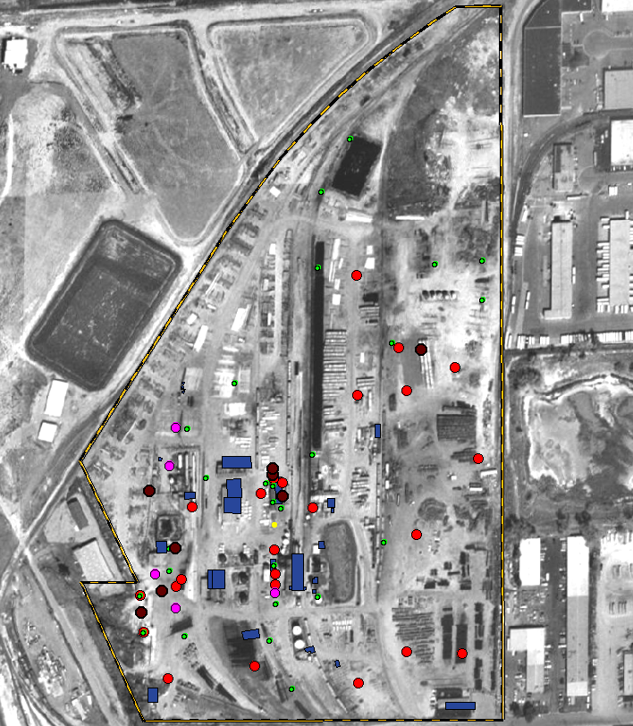
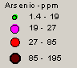
Site Knowledge Post Plots
Depict the location and magnitude of measured concentrations
Look for areas of elevated concentrations, spatial patterns and trends, data errors
Most effective when laid over a site map or aerial photograph
Notes:
Post plots, which are generated easily by any GIS database, are useful tools to initiate the exploration of your site data.
I am sure many of you are already familiar with this technique.
Post plots depict the location and concentration of samples taken in the field.
They are used to look for areas of elevated concentrations, spatial patterns and trends, or data gaps or errors.
These plots are most effective when laid over a site map or areal photograph to enable additional insight as to sources and spread of contamination.
A post plot can provide with initial boundaries between likely-clean and likely-impacted areas.

Slide 91
Site Knowledge Univariate Plots
Plot spatial distribution:
Sample type (surface and subsurface)
Soil types
Location (different sites or sub-areas)
Plotted with Sigma Plot
Notes:
Univariate plots also allow you to compare and segregate your data from many different angles, such as different locations, layers, soil type, sampling periods, etc.
This graphical tool can assist you to distinguish between possible populations.
Univariate plots are often used in background analysis to determine if a constituent is a background chemical or the result of a release.

Slide 92
Advanced Spatial Data Analysis: Geostatistics
Advantage:
Designed for biased, clustered, and correlated spatial data
Disadvantage:
Computationally intensive
Requires training

Slide 93
Geostatistics
Statistical techniques for analysis of spatial data
U.S. EPA has promoted the use of geostatistics in environmental site investigations
U.S. EPA’s pioneering study of lead patterns in Dallas
Produced two public domain software
Recommended in DQO, Attainment of Cleanup and Risk Assessment Guidance
ASTM has published standard guidance for environmental applications of geostatistics

Slide 94
Variogram = Measure of Spatial Correlation between two measured values
Sample variograms are computed for specific separation distances and directions
z_{j}
h_{i,j}
θ_{i,j}
z_{i}

Slide 95
Typical Contamination Patterns
Trend
Structured
Isolated/Separated Hot Spots
Noise
“Each pattern has its own distinct variogram”

Slide 96
Contaminations with Trends
NE
Variogram
Example:
Linear Releases
Large Historic Releases
Trend
Distance

Slide 97
Structured (Continuous) Contaminations
Range
Variogram
Sill
Example: An Aged Plume
Range ~ extent of correlation
Nugget
Spherical
Distance

Slide 98
Isolated Plumes or Hotspots
Range
Variogram
Example:
Plumes surrounded by lower ambient concentrations
Range ~ average extent of plumes
Hole Effect
Distance

Slide 99
Noise Pattern
Variogram
Example:
Post cleanup conditions
“Insignificant pockets of contamination”
Distance
Pure Nugget

Slide 100
Point Kriging
Point Estimation
Z_{o}* = Estimated (kriged) value at x_{o}
z_{i} = Measured value at x_{i}
w_{i} = Estimation (Kriging) weight of z_{i}
Delineation and Contour Maps
Z1
Z2
Zo
Z4
Z3

Slide 101
Block Kriging
Block Estimation
Z_{V}* = Estimated block value at V
Risk Assessment
Z1
Z2
V
Z4
Z3

Slide 102
Kriging Properties
Estimation Criteria:
Unbiasedness (no systematic error)
Minimum variance (most accurate)
Automatic Declustering
Kriging Standard Deviation (KSD)
Measure of accuracy

Slide 103
EPA and Geostatistics
U.S. EPA geostatistics software:
GEO-EAS (Geostatistical Environmental Assessment Software)
http://www.epa.gov/nerlesd1/databases/geo-eas/access.htm
GEOPACK (Geostatistical Software Package)
http://www.epa.gov/nerlesd1/databases/geo-pack/access.htm
U.S. EPA guidance documents recommend geostatistics:
U.S. EPA, Methods for Evaluating the Attainment of Cleanup Standards, Vol. 1. Soil and Solid Media, EPA 230/02-89-042, 1989.
U.S. EPA, Guidance for Data Usability in Risk Assessment, EPA/540/G-90/008, 1990.

Slide 104
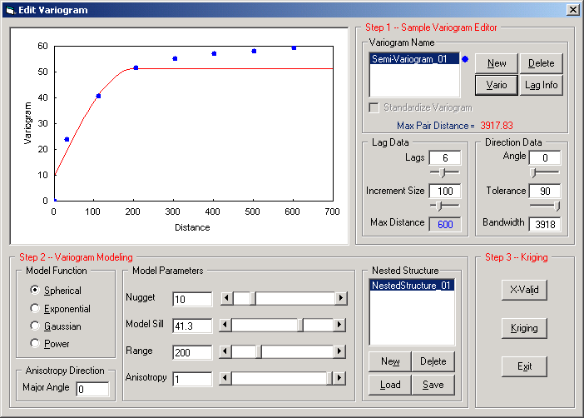
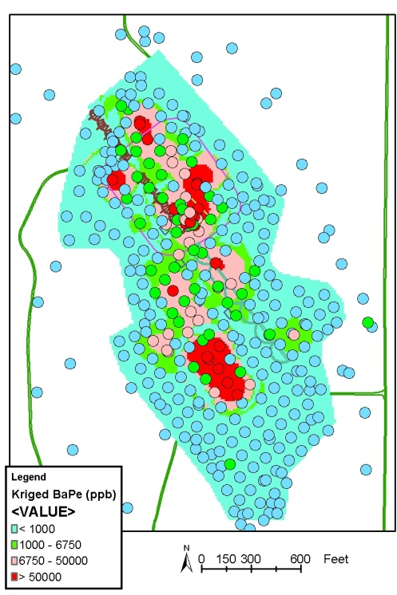
NewFields’ Geostatistics ArcGIS Application: NF_Geostat
Exploratory Data Analysis
Directional Variography
Kriging
Notes:
Mike Wild offers training for ArcGIS and NF_Geostat.

Slide 105
Case Study
Cost Effective Sampling
A technical review of an environmental report was conducted. The consultant proposed an upward limit of 140 samples to the site's already existing 100 samples. The consultant believed that contamination at the site had no structure and therefore required extensive sampling.
Notes:
Present the case study as presented to regulators during a negotiation session on the adequacy of the sampling and analysis plan.

Slide 106
Existing samples
Proposed Sampling
Grid
Proposed samples
Notes:
Consultant’s hypothesis was ‘absence of spatial structure.’
Extensive sampling was proposed for characterization of totally random contamination.

Slide 107
Well Structure Data
Notes:
Geostatistics proved that the Consultant’s hypothesis was wrong.

Slide 108
Existing samples
Cost-Effective &
Sufficient Sampling
Proposed samples
Notes:
As a results a far more focused sampling was proposed.

Slide 109
Topics
Statistics in Environmental Applications
Statistical Modeling
Sample Statistics
Skewed Sample Data
Graphical Techniques
Hypothesis Testing
Field Challenges
Advanced Techniques
Notes:
We have covered many statistical techniques. Now we briefly cover advanced techniques.

Slide 110
Range of Statistical Techniques (From Simple to Complex)
Exploratory Tools
Descriptive Statistics: mean, standard deviation
Graphic Tools: Histogram, box plot, probability plots
Comparative Tools
Two sample tests
Analysis of Variance (ANOVA)
Correlation (Multivariate) Tools
Regression Analysis
Principle Component Analysis (PCA)
Spatial Tools
Geostatistics
Notes:
So far we have investigated the common statistical procedures used in environmental applications, including:
Exploratory Tools, such as
Descriptive Statistics: mean, standard deviation
Graphic Tools: Histogram, box plot, probability plots
Comparative Tools, such as
Two sample tests
However, there are many more advanced statistical techniques that are used in
Environmental applications, such as
Analysis of Variance (ANOVA)
Correlation (Multivariate) Tools, such as
Regression Analysis
Principle Component Analysis
Spatial Tools, such as Geostatistics
Full discussions of these techniques are beyond the scope of this course, however, I will try to highlight some of them through an example.

Slide 111
Multivariate Analysis
So far, we have focused on statistical techniques that analyze one or two variables
Uni-variate: One variable
Descriptive statistics, Hypothesis testing, ….
Bi-variate: Two Variables
Correlation and Regression Analysis
In many instances, we deal with many analytes simultaneously
If variables are expected to be related, then multivariate techniques may be appropriate
Principal Component Analysis

Slide 112
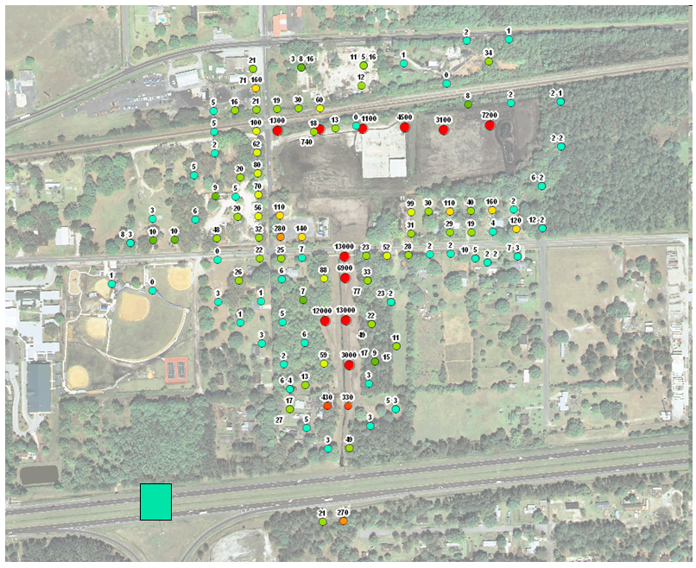
Example: Dioxin/Furan at a Former Wood Treatment Facility

Slide 113
Issues
Is there just a single dioxin population emanating from the site?
Or are there multiple dioxin sources in and around the Site? If yes, what are the characteristics of Site-related versus ambient dioxins?
Do the current soil data provide an adequate basis for delineation of site-related dioxins?

Slide 114
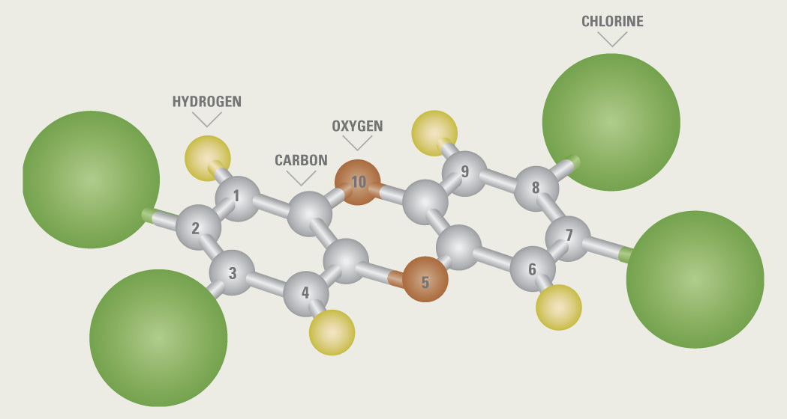
Dioxins/Furans
210 dioxin and furan congeners
17 congeners pose risk
Chlorines at 2,3,7 and 8 positions

Slide 115
Toxicity Equivalency Factors (TEFs)
Compound | WHO 1998 | WHO 2005
Dioxins
Mono-, di- & tri-CDDs | 0 | 0
2,3,7,8-TCDD | 1 | 1
2,3,7,8-PeCDD | 1 | 1
2,3,7,8-HxCDD | 0.1 | 0.1
2,3,7,8-HpCDD | 0.01 | 0.01
OCDD | 0.0001 | 0.0003
Furans
Mono-, di- & tri-CDFs | 0 | 0
2,3,7,8-TCDF | 0.1000 | 0.1000
1,2,3,7,8-PeCDF | 0.05 | 0.03
2,3,4,7,8-PeCDF | 0.5 | 0.3
2,3,7,8-HxCDF | 0.1 | 0.1
2,3,7,8-HpCDF | 0.01 | 0.01
OCDF | 0.0001 | 0.0003

Slide 116
Common Approach Toxicity Equivalent (TEQ)
TEF_{congener 1} x Concentration_{congener 1} +
TEF_{congener 2} x Concentration_{congener 2} +
.
.
.
TEF_{congener 17} x Concentration_{congener 17}
∑
TEQ =
TEQ simplifies the data, but masks the profile

Slide 117

Dioxin/Furan Sources
Dioxins and Furans are not created intentionally, but are produced inadvertently by man-made and natural processes.

Slide 118
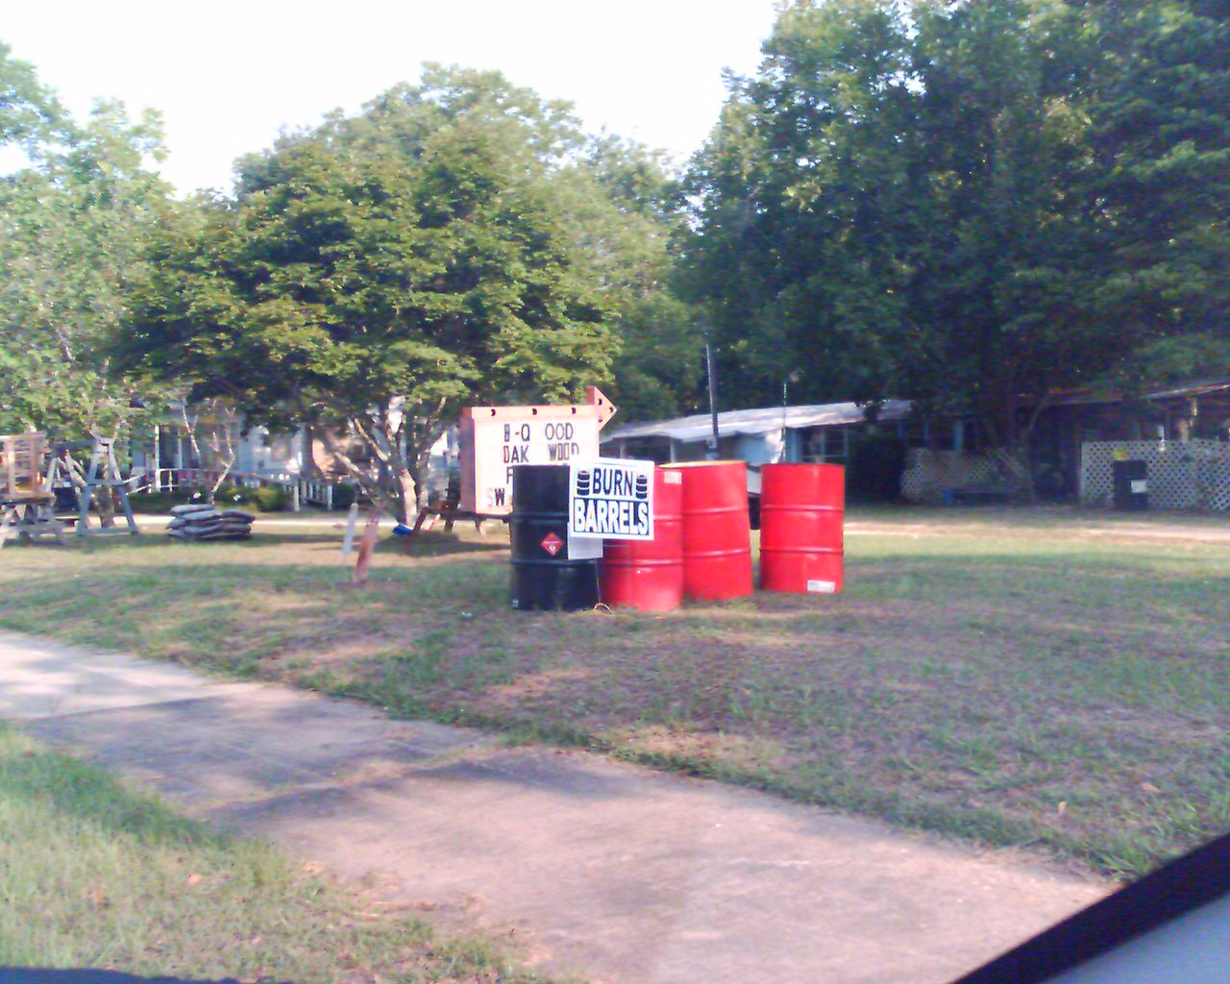
Dioxin National Inventory (2000 Update)
Backyard barrel burning of refuse – 33%
Medical waste/pathological incineration – 25%
Municipal waste combustion – 5%
Vehicle emissions – 5%
Coal-fired utility boilers – 5%
Each source has its own distinct congener profile.

Slide 119
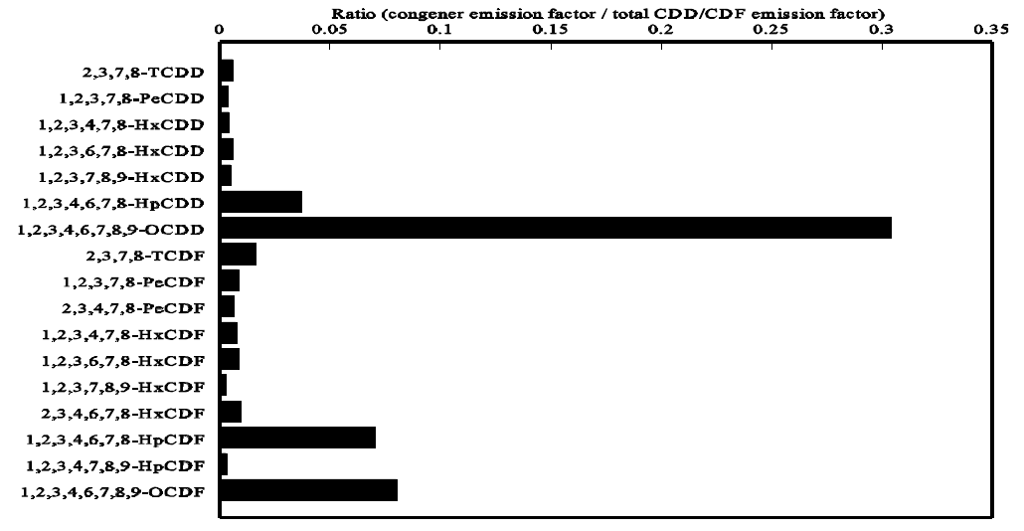
Example of Source-specific Profiles (EPA, 2005)

Slide 120
Dilemma
TEQ simplifies the analysis, but masks congener profile
Delineation required segregating site-related dioxins from ambient
Must analyze 17 congener measurements simultaneously

Slide 121
Principal Component Analysis (PCA)
PCA is a technique for analyzing multi-variable data
Each soil sample contains measurements about 17 congeners (17 variables)
PCA summarizes each sample into a series of scores
In most cases, the first two or three scores adequately summarizes the data
Converting a 17-D problem to a 2-D problem

Slide 122
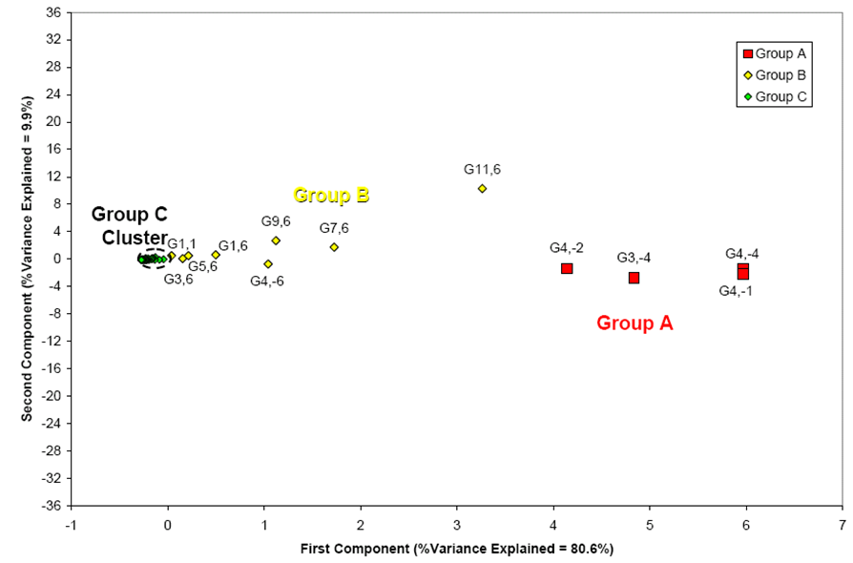
Example: 2-Dimensional PCA Score Plot (explaining nearly 90% of variations)
Group A – Samples with Site-related Congener Profiles
Group B – Samples with Site-Ambient-Mixed Congener Profiles
Group C – Samples with Ambient-related Congener Profiles

Slide 123
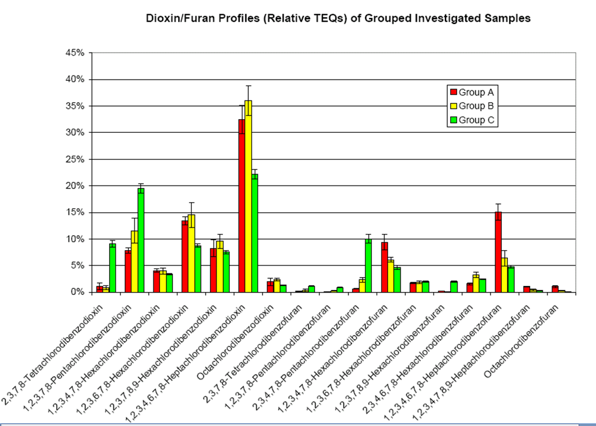

Slide 124
PCA Findings
Dioxin PCA provided a quantitative basis for distinguishing and delineating the extent of Site-impacted soil.
Site-related sources
Historic onsite releases and offsite mixtures
Ambient sources
Backyard trash burning and transportation emissions
Avoid reliance on arbitrary delineations

Slide 125
Suggested Reading
American Society of Civil Engineers (ASCE). 1990a. Review of Geostatistics in Geohydrology, I. Basic Concepts. II. Applications. Prepared by ASCE Task Committee on Geostatistical Tech­niques in Geohydrology, S. Rouhani, Chairman and Principal Author. ASCE Journal of Hydraulic Engineering 116(5): 612–658.
Department of the Navy (DON). 2002. Guidance for Environmental Background Analysis, Volume I: Soil. NFESC User’s Guide UG-2049-ENV. Washington, DC: Naval Facilities Engineering Command. April.
Department of the Navy (DON). 2003. Guidance for Environmental Back­ground Analysis, Volume II: Sediment. NFESC User’s Guide UG-2054-ENV. Washington, DC: Naval Facilities Engineering Command. April.
Department of the Navy (DON). 2004. Guidance for Environmental Back­ground Analysis, Volume III: Groundwater. NFESC User’s Guide UG-2059-ENV. Washington, DC: Naval Facilities Engineering Command. April.
Gilbert, R.O. 1987. Statistical Methods for Environmental Pollution Monitoring. New York: Van Nostrand Reinhold.
Helsel, D.R., and R.M. Hirsch. 1992. Statistical Methods in Water Resources. New York: Elsevier.
Isaaks, E.H., and R.M. Srivastava. 1989. Applied Geostatistics. Cambridge, England: Oxford University Press.
Singh, A. K., A. Singh, M. Engelhardt. 1999. “Some Practical Aspects of Sample Size and Power Computations for Estimating the Mean of Positively Skewed Distributions in Environmental Applications”. EPA/600/s-99/006. OSWWR.
United States Environmental Protection Agency (U.S. EPA). 1989. Statistical Methods for Evaluating the Attainment of Cleanup Standards, Vol. 1: Soils and Solid Media. EPA 230/02-89-042. Washington, DC: Office of Policy, Planning, and Evaluation.
United States Environmental Protection Agency (U.S. EPA). 1989. Methods for Evaluating the Attainment of Cleanup Standards, Vol. 2: Groundwater. EPA 230-R-92-14. Washington, DC: Office of Policy, Planning, and Evaluation.
United States Environmental Protection Agency (U.S. EPA). 1992a. Statistical Analysis of Ground-Water Monitoring Data at RCRA Facilities – Addendum to Interim Final Guidance. Washington, DC: Office of Solid Waste, Permits and State Programs Division. June.
United States Environmental Protection Agency (U.S. EPA). 1992b. Supplemental Guidance to RAGS: Calculating the Concentration Term. EPA Publication 9285.7-081. May.
United States Environmental Protection Agency (U.S. EPA). 1994b. Statistical Methods for Evaluating the Attainment of Cleanup Standards, Vol. 3: Reference-Based Standards for Soils and Solid Media. EPA 230-R-94-004. Washington, DC: Office of Pol­icy, Planning, and Evaluation.
Notes:
This slide includes a series of suggested readings. I have included key EPA and Navy guidance documents for your consideration.

